Slide 1
Gamma-400 “new” calorimeter status
Oscar Adriani
INFN and University of Florence
Trieste, May 5th, 2013

Slide 2
Starting point
The starting point is the presentation at the Moscow meeting in February
No change in the proposed structure
New results from:
Simulation (Rejection factor)
Test beam data analysis
Meanwhile we have provided to Russian colleagues the description of the pre-prototype, that will be sent in Russia
The electrical interface document is under preparation by Trieste peoples
The calorimeter proposal should be updated according to the discussion under way in Russia:
increase the weight of the payload
Increase the top surface of the calorimeter to increase the gamma acceptance
Scaling of the calorimeter is feasible and should be studied

Slide 3
The proposed configuration: CsI(Tl) ~ 1680 kg
 | Cubes
N×N×N | 20×20×20
L of small cube (cm) | 3.6*
Crystal volume (cm³) | 46.7
Gap (cm) | 0.3
Mass (Kg) | 1683
N.Crystals | 8000
Size (cm³) | 78.0×78.0×78.0
Depth (R.L.) “ (I.L.) | 39×39×39 1.8×1.8×1.8
Planar GF (m²sr) ** | 1.91
Very deep!!!!
(* one Moliere radius)
(** GF for only one face)

Slide 4
The readout sensors
Minimum 2 Photo Diodes are necessary to cover the whole huge dynamic range
1 MIP→10⁷ MIPS, since E_{max} in one crystal ~ 0.1 E_{tot}
Large Area Excelitas VTH2090 9.2 x 9.2 mm² for small signals → Inserted in the simulation!
Small area 0.5 x 0.5 mm² for large signals
Two independent readout channels will be used
Details later on!

Slide 5
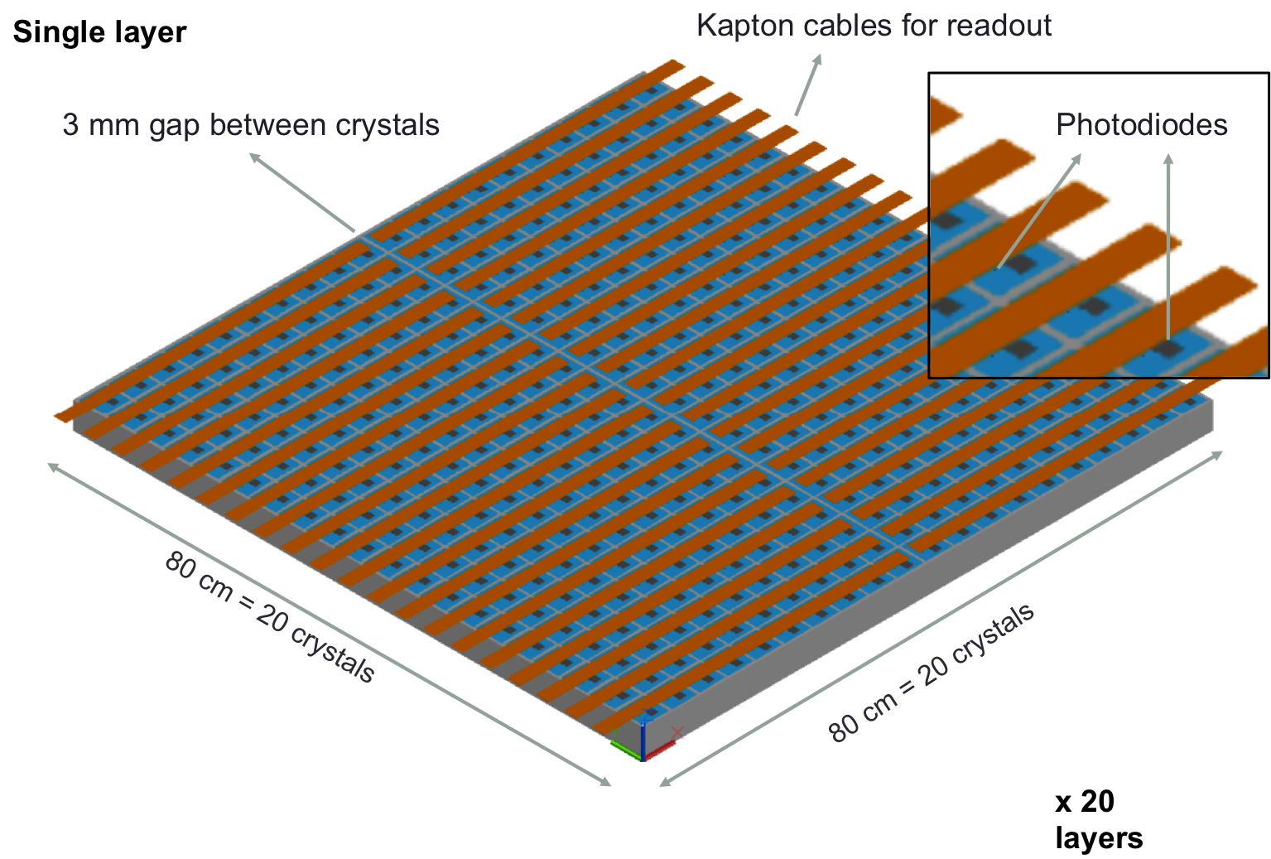
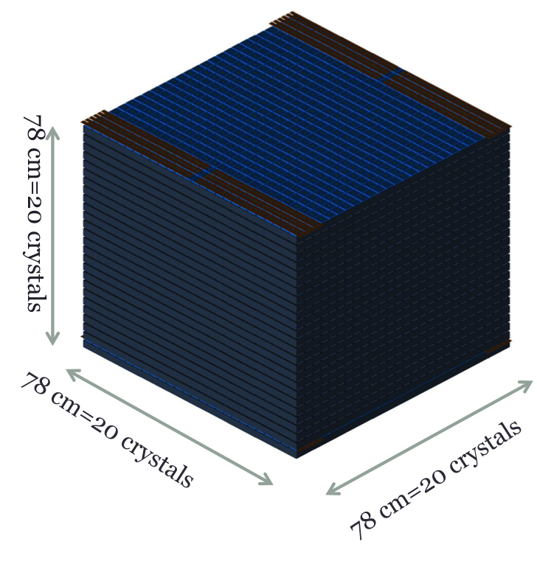
Mechanical idea

Slide 6
Simulation
FLUKA based simulation
Planar generation surface on one of the 5 faces
Results valid also for the other faces!
Carbon fiber in between crystals (3 mm gaps)
Large photodiode is inserted on the crystal in the simulation
We take into account also the energy release in the Photodiode itself!
Results are valid for every face since scintillation light is isotropically emitted
Electrons: 100 GeV – 1 TeV range
Protons: 100 GeV – 100 TeV range
~ 100 – 10.000 events for each energy
No mis-calibration effects are included in the simulation
Light collection efficiency and PD quantum efficiency are included in the simulation
For the moment we have very low statistics for high energy particles (huge computing time is necessary….)

Slide 7
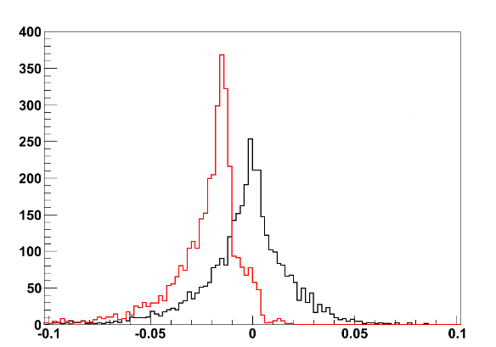
Electrons
Electrons 100 – 1000 GeV
RMS~2%
Selection efficiency:
ε ~ 36%
GF_{eff} ~ 3.4 m²sr
Crystals only
Crystals + photodiodes
Non-gaussian tails due to leakages and to energy losses in carbon fiber material
(Measured Energy – Real Energy) / Real Energy
Ionization effect on PD: 1.7%

Slide 8
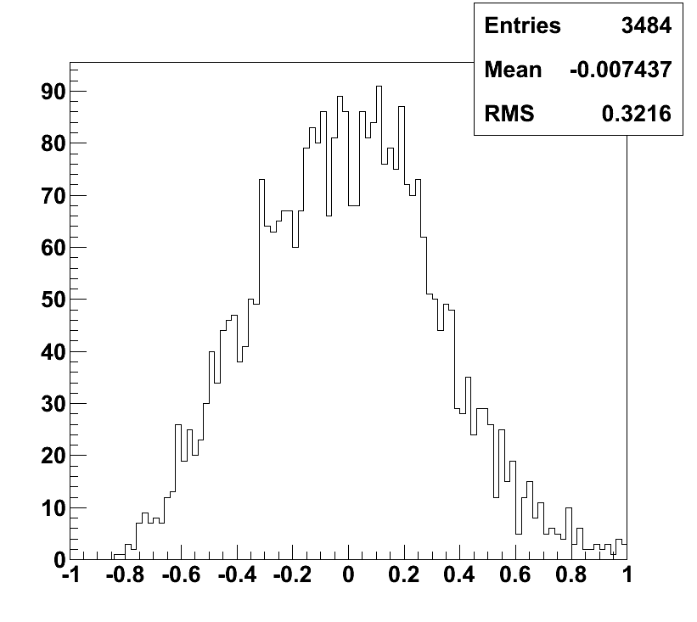
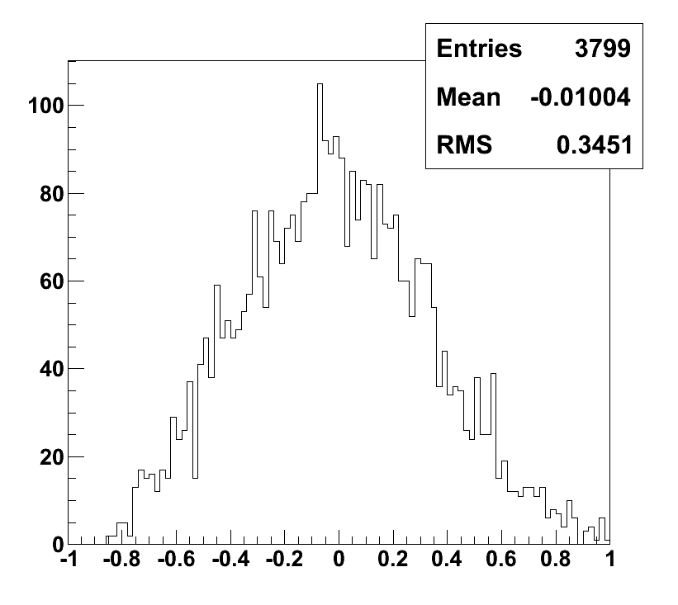
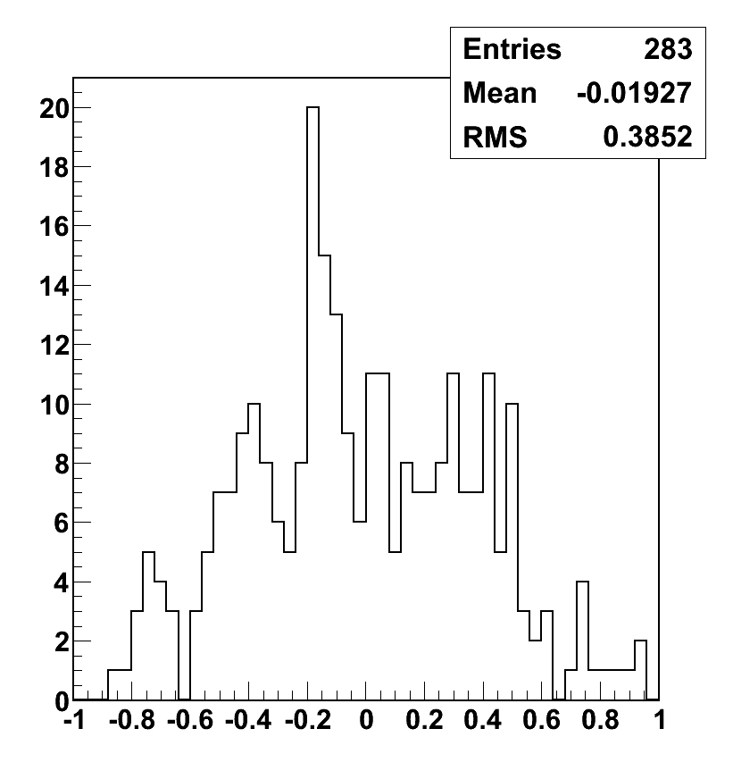
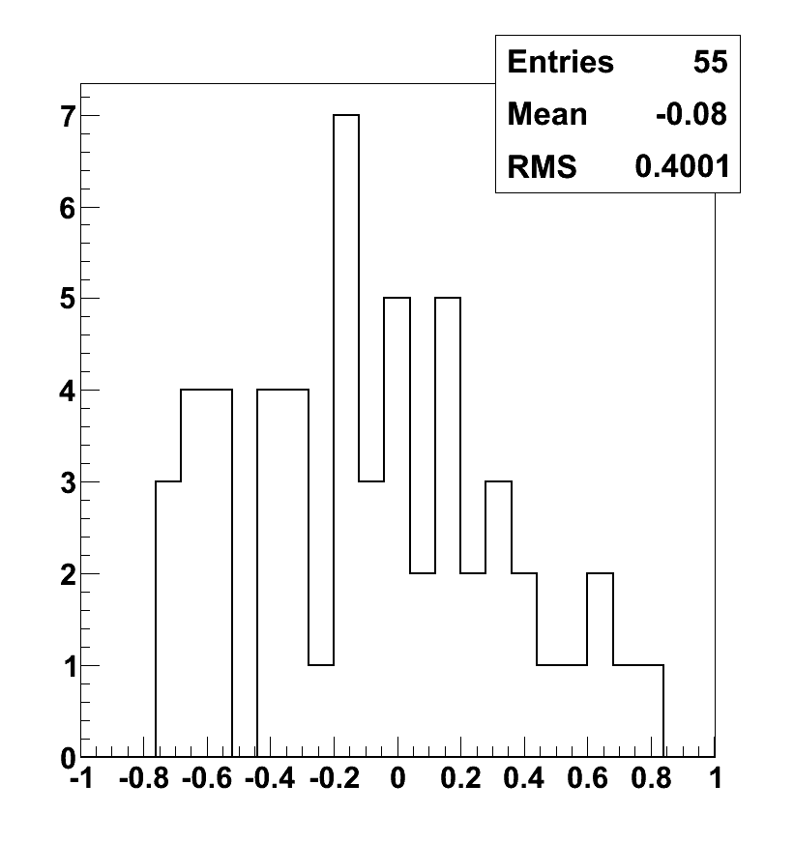
Protons
Energy resolution
100 – 1000 GeV
1 TeV
Selection efficiencies:
ε^{0.1-1TeV} ~ 35%
ε^{1TeV} ~ 41%
ε^{10TeV} ~ 47%
GF_{eff}^{0.1-1TeV} ~ 3.3 m²sr
GF_{eff}^{1TeV} ~ 3.9 m²sr
GF_{eff}^{10TeV} ~ 4.5 m²sr
32%
35%
(Measured Energy – Real Energy) / Real Energy
(Measured Energy – Real Energy) / Real Energy
10 TeV
100 TeV
39%
40%
(Measured Energy – Real Energy) / Real Energy
(Measured Energy – Real Energy) / Real Energy

Slide 9
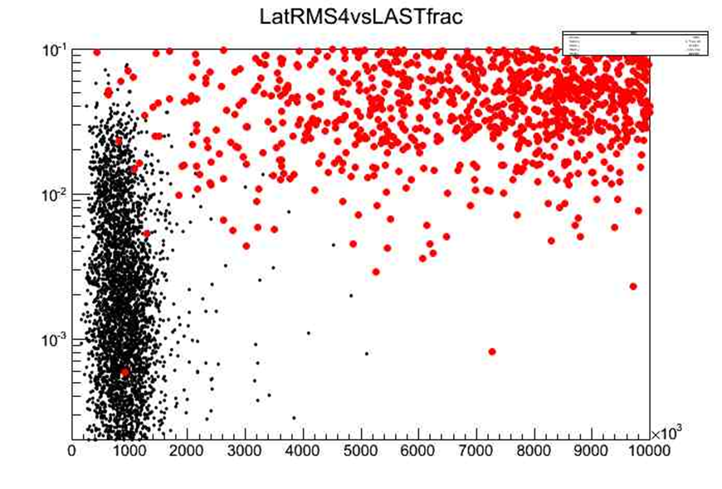

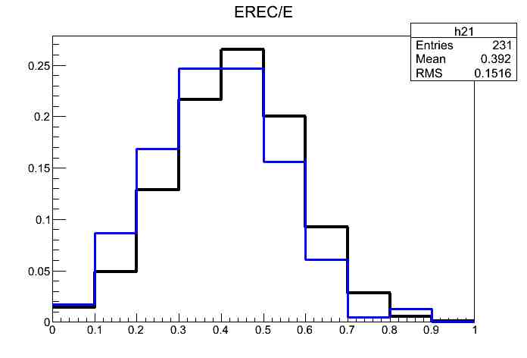


Proton rejection factor
Montecarlo study of proton contamination
using CALORIMETER INFORMATIONS ONLY
PARTICLES propagation & detector response simulated with FLUKA
Geometrical cuts for shower containment
Cuts based on longitudinal and lateral development
155.000 protons simulated at 1 TeV : only 1 survive the cuts
The corresponding electron efficiency is 37% and almost constant with energy above 500gev
Mc study of energy dependence of selection efficiency and calo energy distribution of misreconstructed events
LONGITUDINAL
protons
λ1
10TeV
electrons
1TeV
LatRMS4
LATERAL
$$\frac{dF\left(ν,λ\right)}{dν}$$

Slide 10
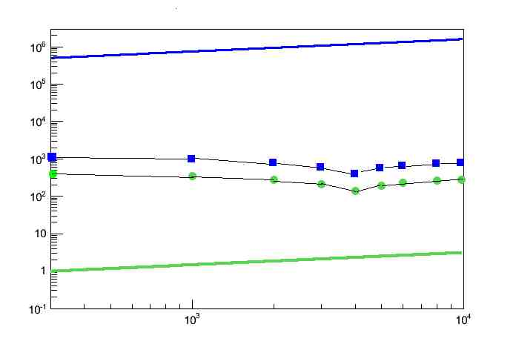
Proton rejection factor
Protons in acceptance(9,55m²sr)/dE
Contamination :
0,5% at 1TeV
2% at 4 TeV
vela
E³dN/dE(GeV² ,s⁻¹ )
Electrons in acceptance(9,55m²sr)/dE
Electrons detected/dE_{cal}
An upper limit
90% CL is obtained
using a factor X 3,89
Protons detected as electrons /dE_{cal}
E(GeV)
= = 0,5 x 10⁶
X Electron Eff. ~ 2 x 10⁵

Slide 11
The prototypes and the test beams
Two prototypes have been built at INFN Florence, with the help of INFN Trieste, INFN Pisa and University of Siena.
A small, so called “pre-prototype”, made of 4 layers with 3 crystals each
12 CsI(Tl) crystals, 2.5x2.5x2.5 cm³
A bigger, properly called “prototype”, made of 14 layers with 9 crystals each
126 CsI(Tl) crystals, 3.6x3.6x3.6 cm³
Both devices have been tested at CERN SPS (pre-prototype in October 2012 and prototype in January-February 2013)

Slide 12
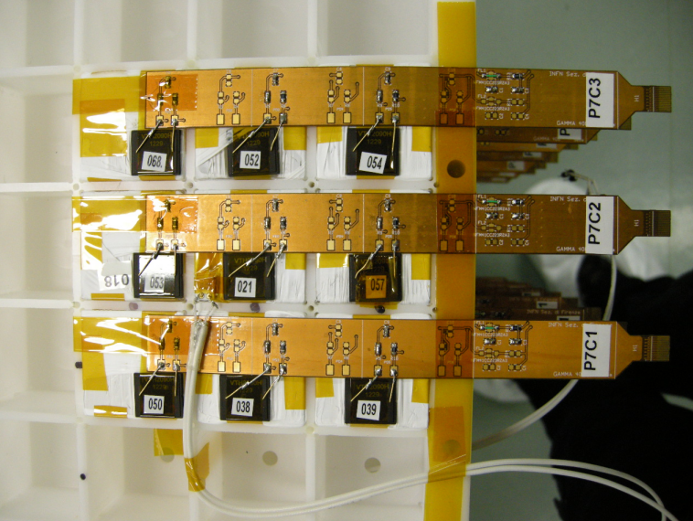
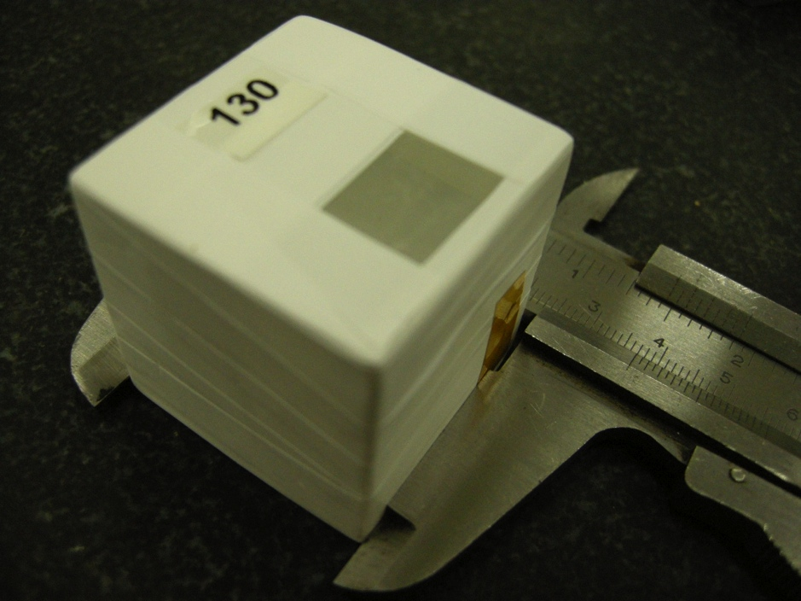
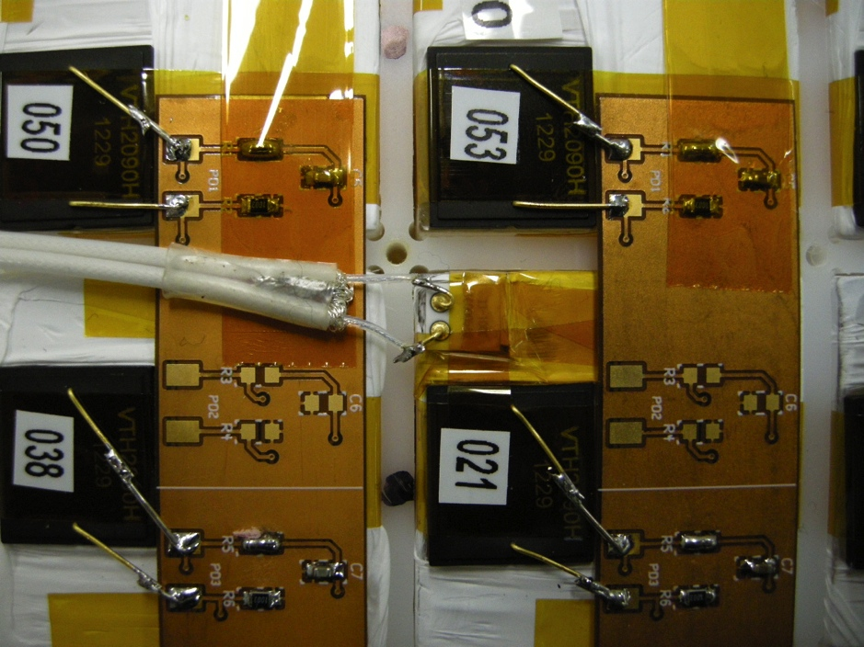
The prototype

Slide 13
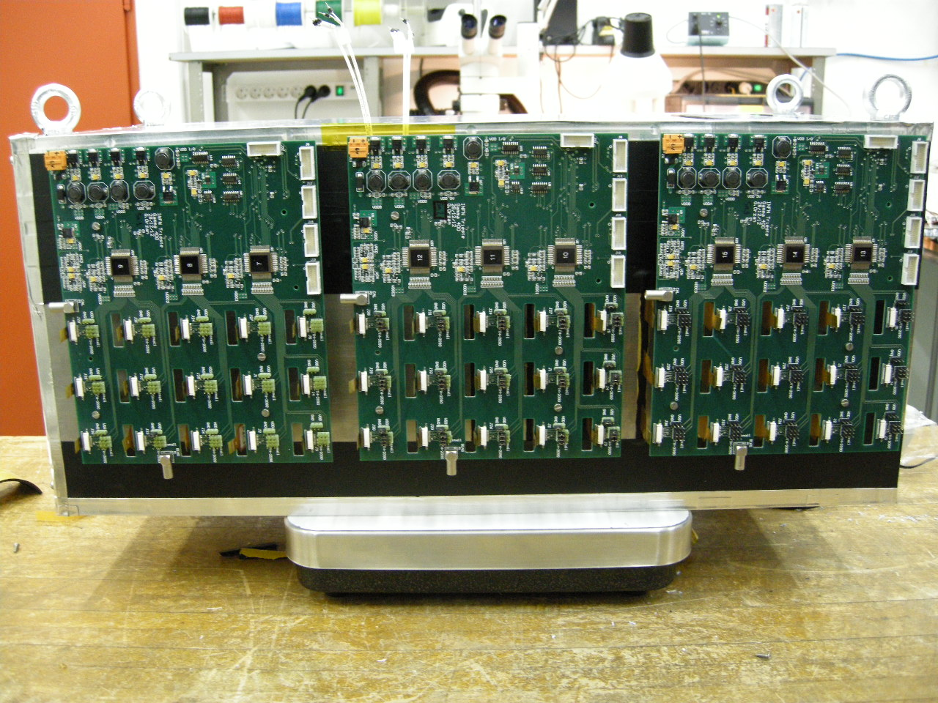
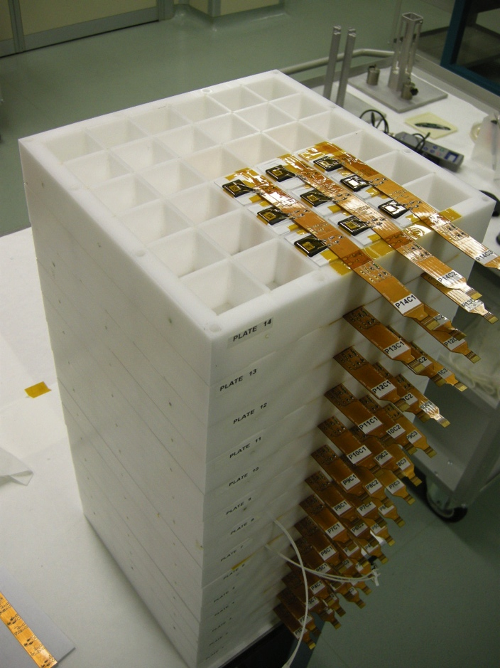
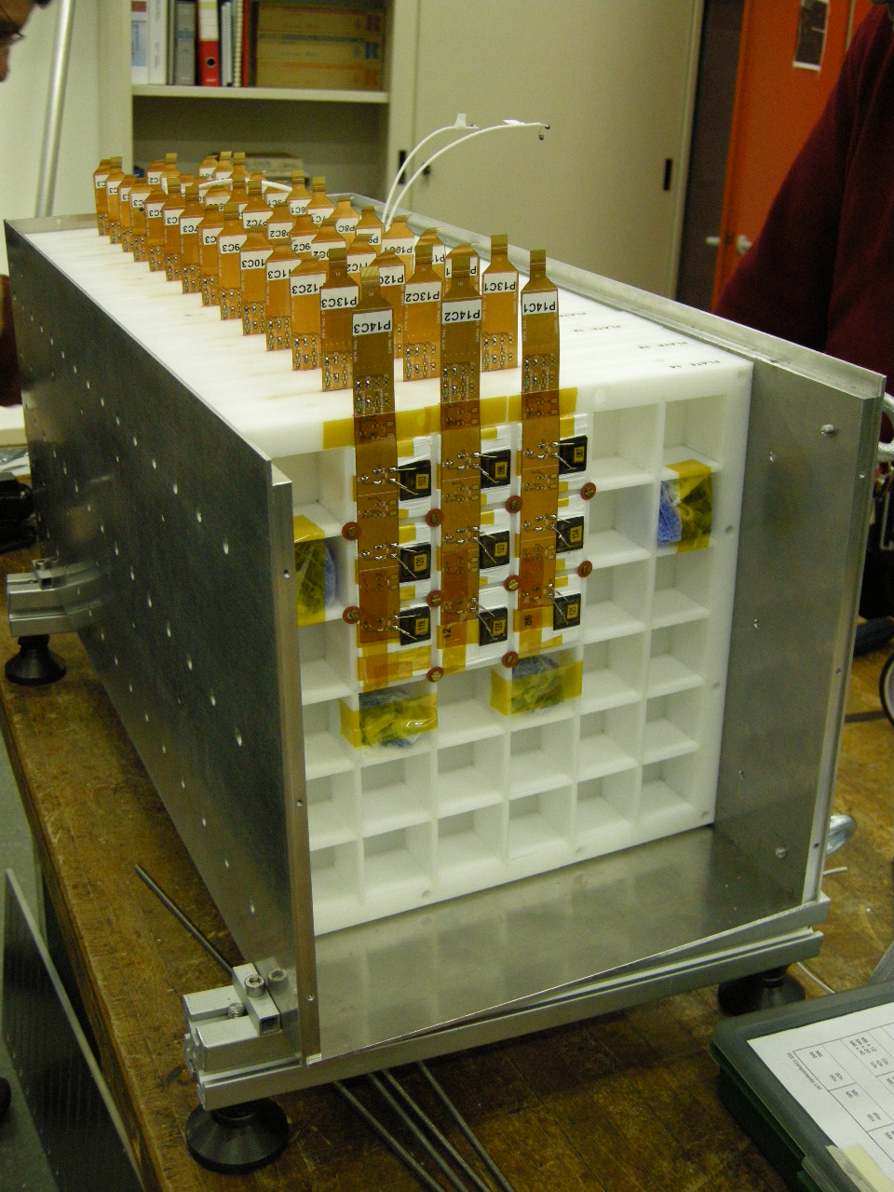
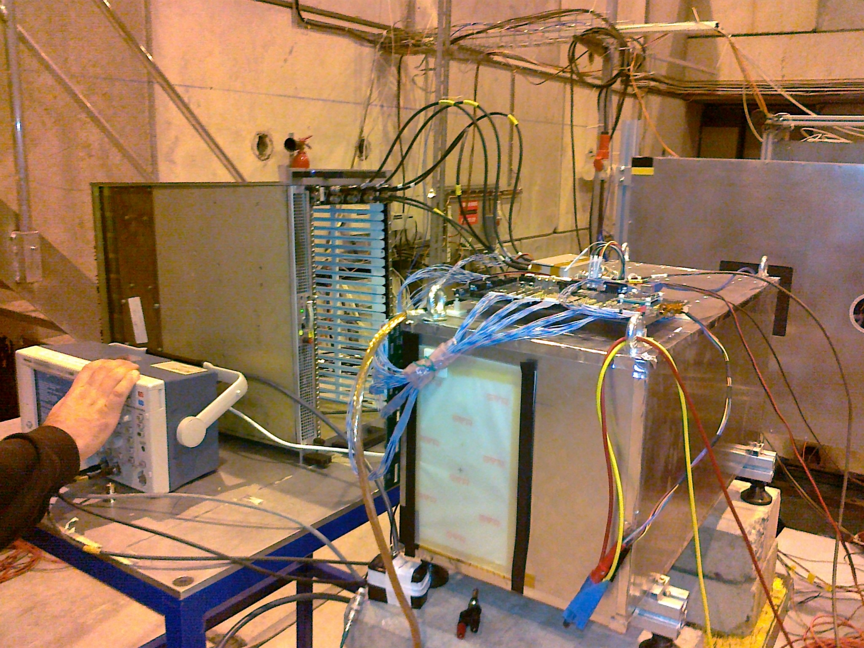
The prototype

Slide 14
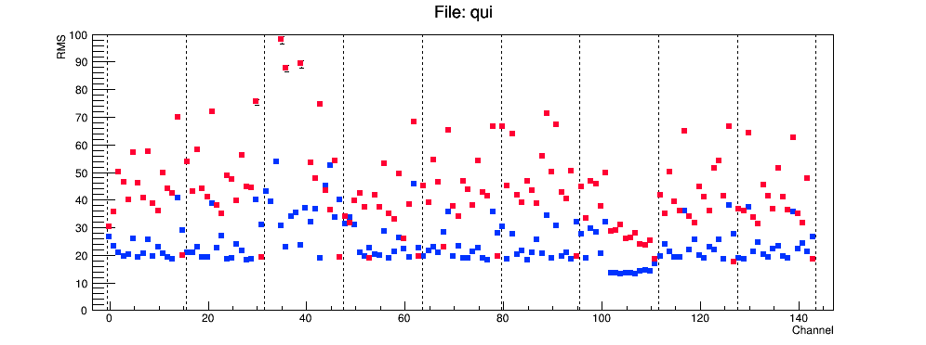
Noise
WITH and WITHOUT CN subtraction
CN evaluated with disconnected channels and 4-sigma cut

Slide 15
Noise studies
The noise of the 16 CASIS channels is correlated, but not in a clear way (for example the correlation coefficient for the disconnected channels is not very high)
When we have a shower it is not so clear how to compute the CMN
Disconnected channels do not give a good estimate
It is not so clear how to identify the signals without signals (if there are….)
Result → The CMN subtraction does not give clear advantages, mainly if showers are present…

Slide 17
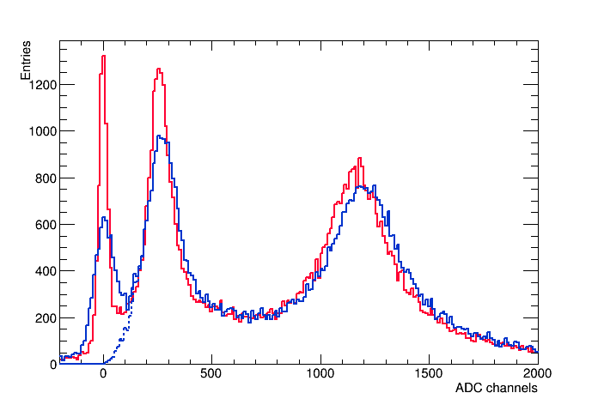
Hit definition
S’=ADC-PED-CN
S=ADC-PED
Hit defined by 4-sigma cut on S’

Slide 18
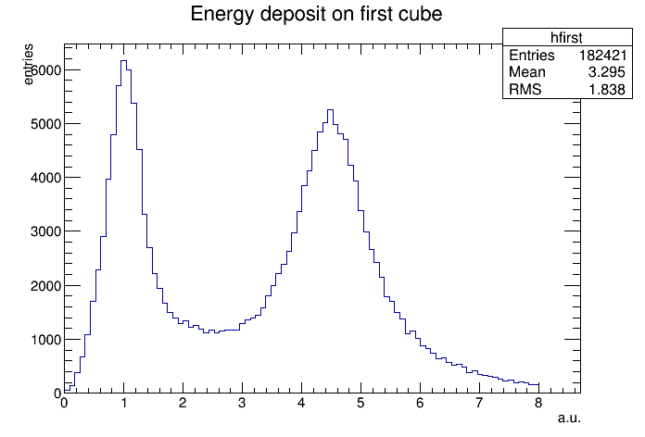
30GV
Z=1
Z=2
First layer used to select Z=1 and Z=2 nuclei.

Slide 19
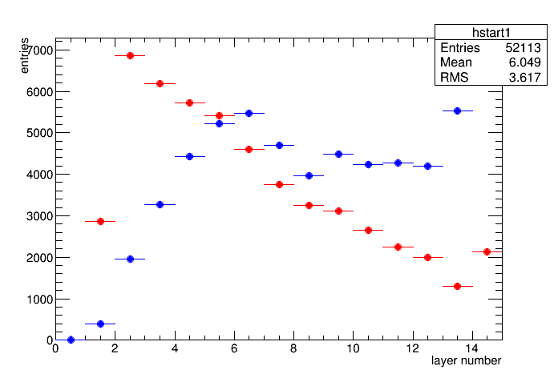
30GV
Z=1
Layer with MAX hit
Shower START → First layer with a hit > 15 MIP

Slide 20
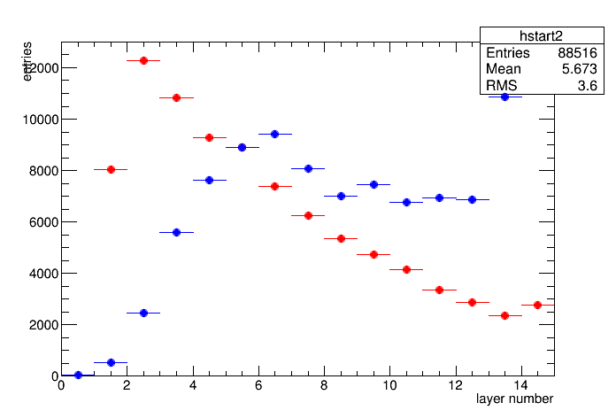
30GV
Z=2
Layer with MAX hit
Shower START → First layer with a hit > 15 MIP

Slide 21
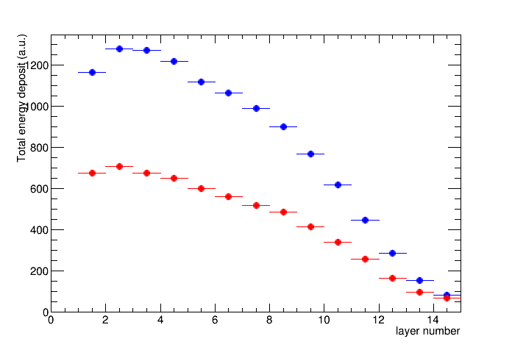
Total energy deposit VS shower-starting layer
30GV
Z=2
Z=1
Maximal containment when starting-layer == 2

Slide 22
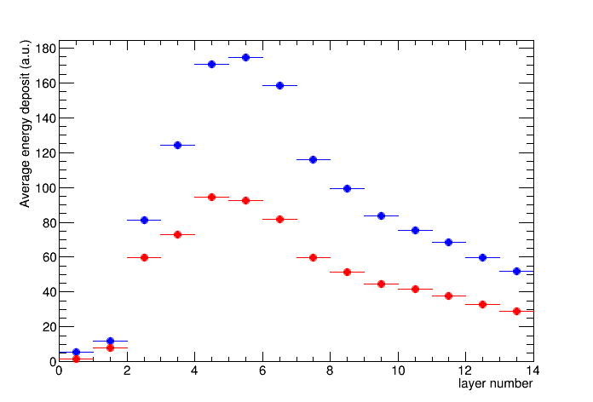
Average longitudinal profile
30GV
Z=2
Z=1
(Starting layer == 2)

Slide 23
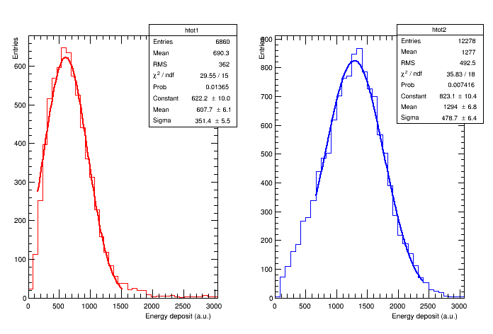
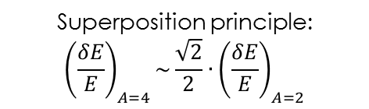
Energy resolution
∼58% (fit)
∼37% (fit)
Superposition principle:
$${\left(\frac{δE}{E}\right)}_{A=4}\sim \frac{\sqrt{2}}{2}{∙\left(\frac{δE}{E}\right)}_{A=2}$$
Z=2
Z=1
30 GV
Starting-layer ==2

Slide 24
Calibation of the crystals
Before calibration
After calibration

Slide 25
Response uniformity of the crystals
~14% Uniformity

Slide 26
A strange effect….
To be checked!!!
Particles hitting the PD?
Effect seen by Ferm????

Slide 27
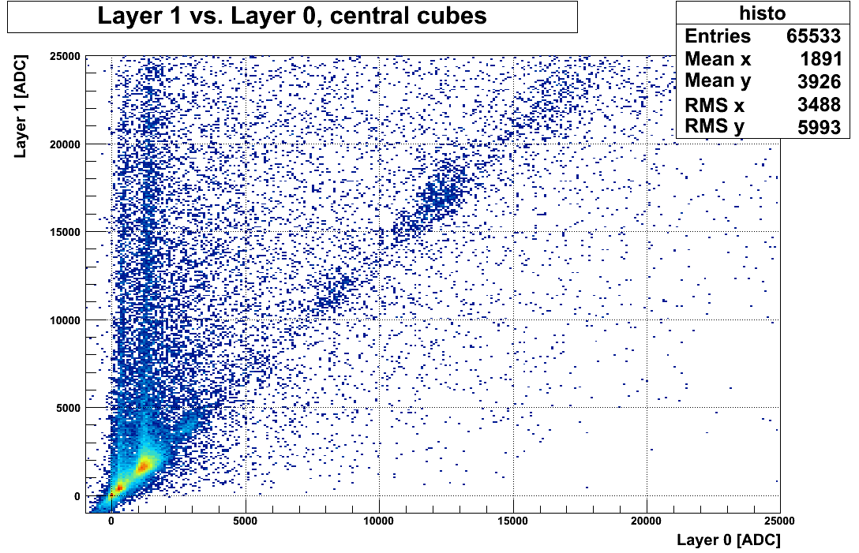
A glance at prototype's TB data
N
C
Please remind that this is a calorimeter!!!!
Not a Z measuring device!!!!
B
H: Z=1 <ADC>=330
He: Z=2 <ADC>=1300
Li: Z=3 <ADC>=3000
Be: Z=4 <ADC>=5300
B: Z=5 <ADC>=8250
C: Z=6 <ADC>=12000
N Z=7 <ADC>=16000
Be
Li
He

Slide 28
Energy deposit for various nuclei
Charge is selected with the placed-in-front tracking system
Good Linearity even with the large area PD!
Preliminary
Courtesy of Pi-Si group

Slide 29
Courtesy of Pi-Si group

Slide 30
How to improve the calorimeter performances?
We could try to see the Cherenkov light produced in the crystals by the electromagnetic component of the shower
Improvement of the e/p rejection factor
Improvement of the hadronic energy resolution (DREAM project)
Problem: different response to electromagnetic and hadronic particles (e/h>1)
Effect: worsening of energy resolution
Solution: try to compensate the hadronic response to make it equal to electromagnetic one
‘Software compensation’ developed in the last few years
Hardware compensation (~late 1980)

Slide 31
Some ideas for the Cherenkov light
Use of SiPM to detect Cherenkov light
Discrimination btw Fast Cherenkov light and Slow Scintillation light possible with dedicated fast sampling electronics
Use of SiPM highly sensitive in the UV region
Use of ‘UV transmitting’ filters on the SiPM face
to block the largely dominant scintillation light
Possible use of ≥3 SiPM for each crystal on orthogonal faces
to have a good uniformity in the response for particles hitting the different calorimeter’s faces
Dedicated test beam at INFN-Frascati in October
700 MeV electron beams
Few crystals equipped with UV-transmitting filters and SiPM

Slide 32
Which Calorimeter can we put in Gamma-400?
Basic idea: remove CC1, use only CC2
Few layers of silicon in between the first few layers of crystals to obtain the desired angular resolution are possible
Remind:
Basic CCUBE:
0.78m x 0.78m x 0.78m=0.475 m3, 8000 crystals, 1683 kg
Starting russian design (from Sergey design):
9400 crystals + 2 X0 CC1=9400+’784 equivalent crystals’=10180 crystals, 2140 kg
Possible proposal:
A Dream….: 1m x 1m x 0.8 m: 13.300 crystals, 2790 kg
Still a Dream…: 1m x 1m x 0.7 m: 11.600 crystals, 2440 kg
A Realistic Dream: 1m x 1m x 0.65 m: 10.800 crystals, 2260 kg
A very good det.: 1m x 1m x 0.6 m: 9.975 crystals, 2090 kg

Slide 33
Conclusion
An homogeneous, isotropic calorimeter looks to be an optimal tool for Gamma-400-N
The status of the project is quite advanced:
Simulation
Prototypes
Test beams
Next steps:
R&D on the Cherenkov light during 2013 and 2014
Possibly enlarge the prototype’s dimensions
Low energy electron test beam in INFN Frascati in autumn 2013
Test at Serpukhov with high energy protons and electrons in 2014
R&D for the Calibration system of every crystal is certainly necessary!
Possible synergy and help from the russian colleagues for this item?

Slide 34
Backup

Slide 35
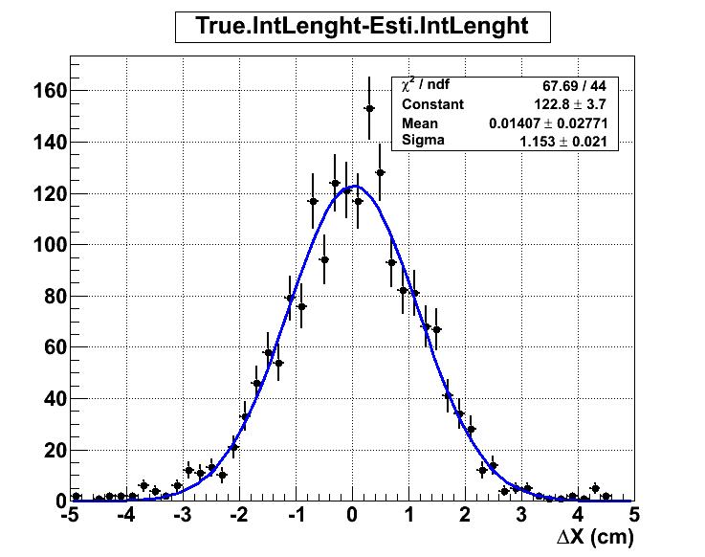
Shower starting point resolution
<ΔX> = 1.15 cm

Slide 36
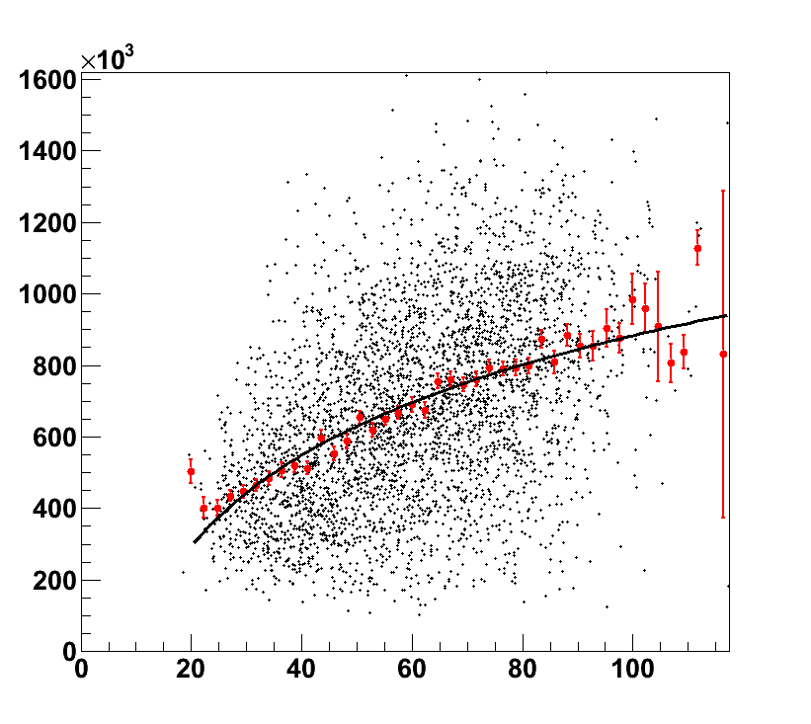
Proton 1 TeV
Signal / Energy
Shower Length (cm)

Slide 37
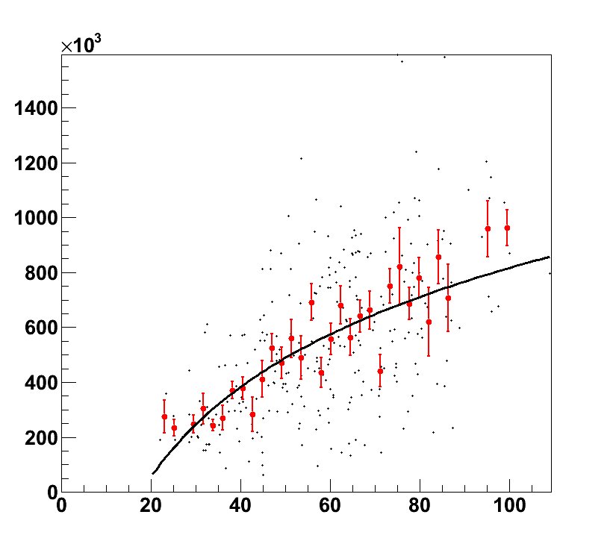
Proton 10 TeV
Signal / Energy
Shower Length (cm)

Slide 38
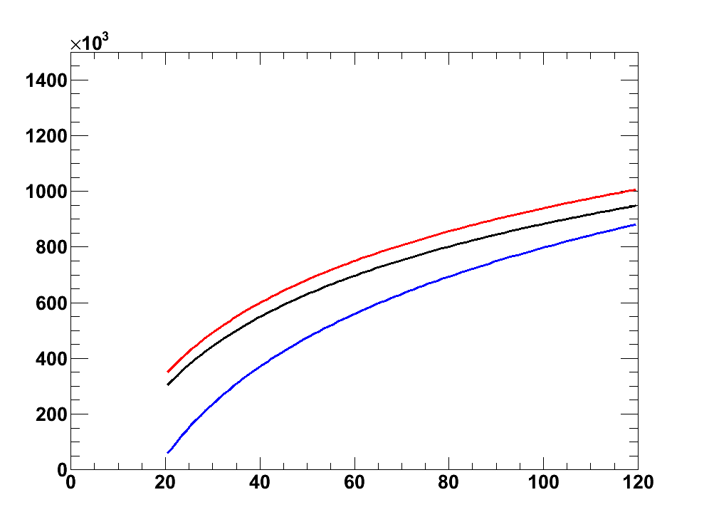
Calibration curves
Signal / Energy
100 – 1000 GeV
10 TeV
1 TeV
Shower Length (cm)

Slide 39
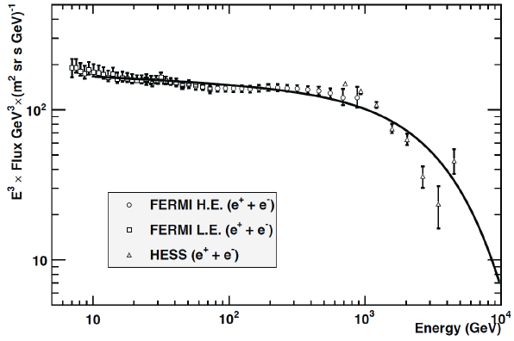
Counts estimation, electrons
G400 configuration: CsI(Tl), 20x20x20 crystals
Size: 78.0x78.0x78.0 cm³ – gap 0.3 cm
Taking into account: geometrical factor and exp. duration +
selection efficiency 80%
Experiment | Duration | Planar GF (m² sr) | Calo σ(E)/E | Calo depth | e/p rejection factor | E > 0.5 TeV | E > 1 TeV | E > 2 TeV | E > 4 TeV
CALET | 5 y | 0,12 | ~2% | 30 X₀ | 10⁵ | 3193 | 611 | 95 | 10
AMS02 | 10 y | 0,5** | ~2% | 16 X₀ | 10^{3 **} | 26606 | 5091 | 794 | 84
ATIC | 30 d | 0,25 | ~2% | 18 X₀ | 10⁴ | 109 | 21 | 3 | 0
FERMI | 10 y | 1,6@300 GeV * 0,6@800 GeV * | ~15% | 8,6 X₀ | 10⁴ | 59864 | 2545 | 0 | 0
G400 | 10 y | 8,5 | ~0,9% | 39 X₀ | 10⁶ | 452303 | 86540 | 13502 | 1436
* efficiencies included
** calorimeter standalone

Slide 40
Counts estimation, protons and helium nuclei
Polygonato model
G400 configuration: CsI(Tl), 20x20x20 crystals
Size: 78.0x78.0x78.0 cm³ – gap 0.3 cm
Taking into account: geometrical factor and exp. duration + selection
efficiency 80%
~ knee
Experiment | Duration | Planar GF (m² sr) | ε sel | Calo σ(E)/E | Calo depth | E > 0.1 PeV |  | E > 0.5 PeV |  | E > 1 PeV |  | E > 2 PeV |  | E > 4 PeV
 |  |  | ε conv |  |  | p | He | p | He | p | He | p | He | p | He
CALET | 5 y | 0,12 | 0,8 | ~40% | 30 X₀ 1,3 λ₀ | 146 | 138 | 9 | 10 | 2 | 3 | 1 | 1 | 0 | 0
 |  |  | 0,5
CREAM | 180 d | 0,43 | 0,8 | ~45% | 20 X₀ 1,2 λ₀ | 41 | 39 | 3 | 3 | 1 | 1 | 0 | 0 | 0 | 0
 |  |  | 0,4 CT*
ATIC | 30 d | 0,25 | 0,8 | ~37% | 18 X₀ 1,6 λ₀ | 5 | 5 | 0 | 0 | 0 | 0 | 0 | 0 | 0 | 0
 |  |  | 0,5 CT*
G400 | 10 y | 8,5 | 0,8 | ~17% | 39 X₀ 1,8 λ₀ | 16521 | 15624 | 979 | 1083 | 261 | 326 | 60 | 92 | 10 | 21
 |  |  | 0,4
* carbon target

Slide 41
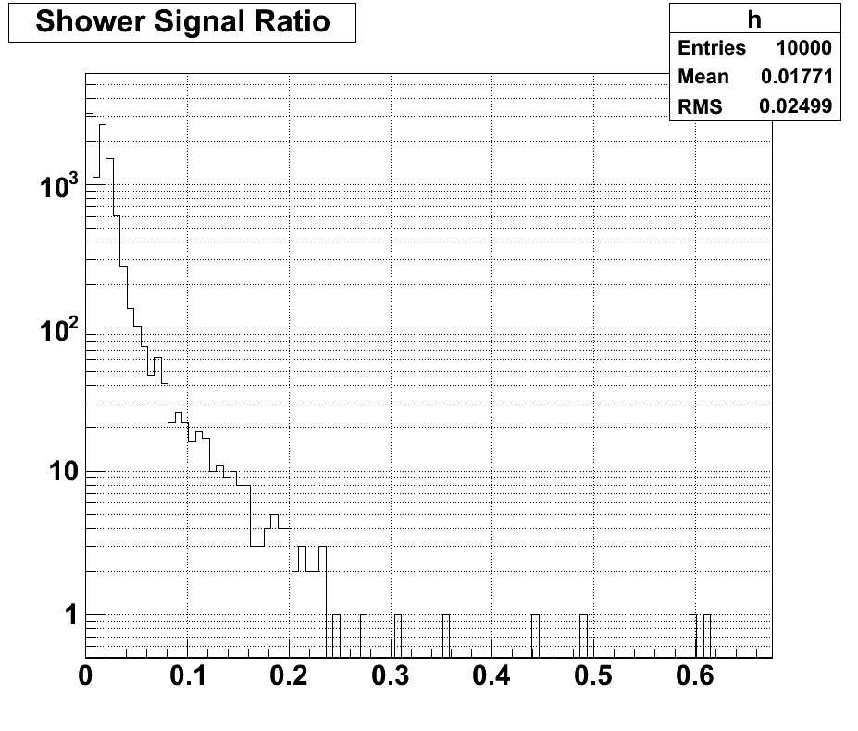
Electrons
Total silicon signals / Total crystal signals

Slide 42
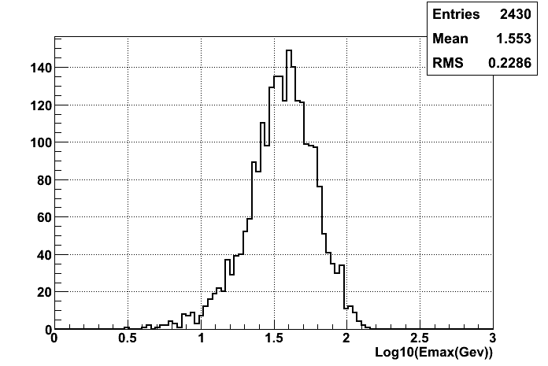
E_{max} ~ 0.1× E_{tot}

Slide 43
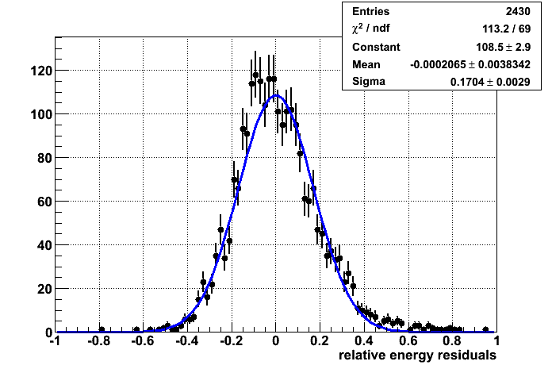
Energy resolution
ΔE = 17%

Slide 44
Electrons
Very simple geometrical cuts:
The track should point to a fiducial surface (two crystals on the side are eliminated)
The maximum of the shower should be well contained in the fiducial volume
The length of the shower should be at least 40 cm (~21 X₀)
Efficiency of these cuts~ 36%
Effective geometrical factor ~
(0.78*0.78*π)∗5∗ε m² sr= 9.55*ε m² sr
Gf_{eff}~3.4 m²sr (including the efficiency)
calorimeter

Slide 45
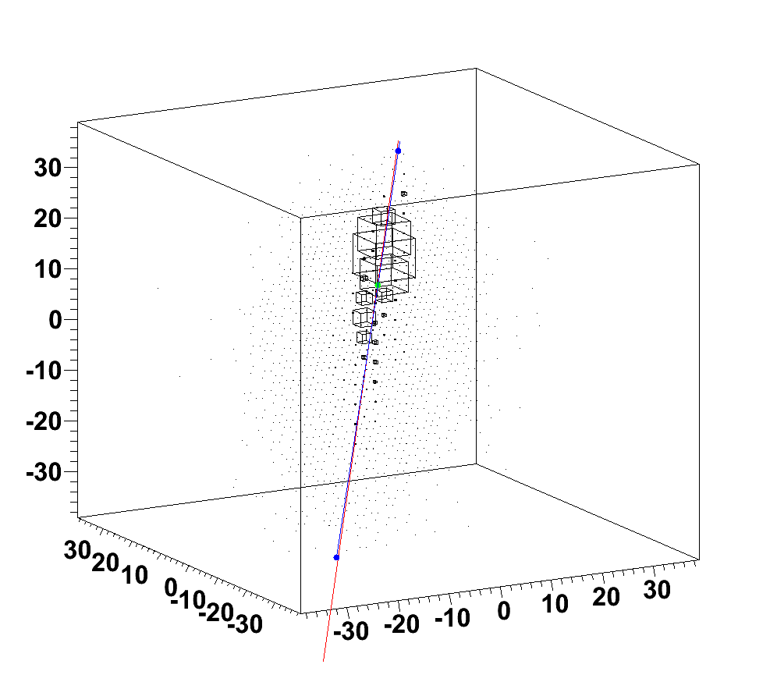
Electron #1

Slide 46
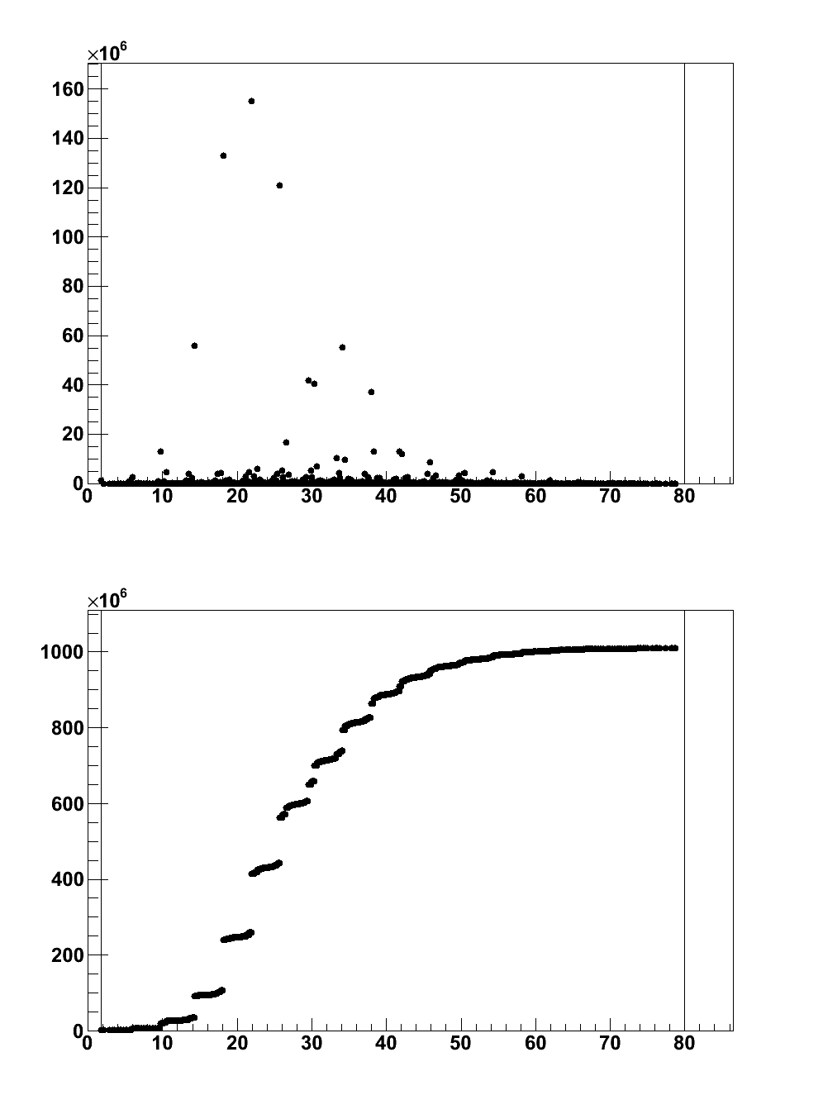
Longitudinal profile
Electron #1
Signal
cm
Integral Signal
cm

Slide 47
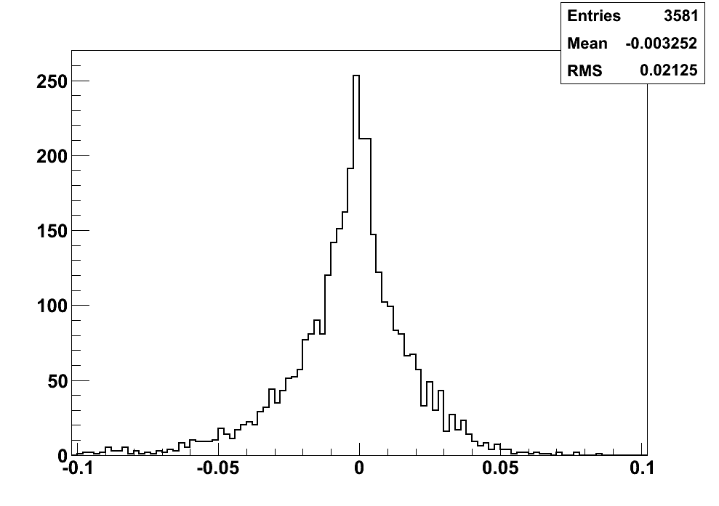
Electrons 100 – 1000 GeV
Energy resolution
Non gaussian tails due to leakages and to the carbon fiber material
RMS~2%
( Measured Energy – Real Energy ) / Real Energy

Slide 48
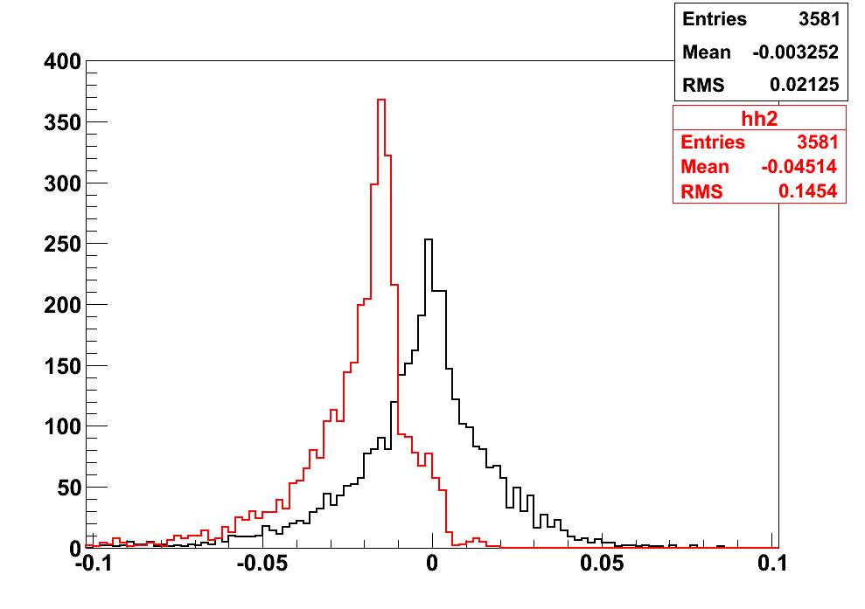
Electrons 100 – 1000 GeV
Crystals only
Crystals + Photodiodes
1.7% difference
( Measured Energy – Real Energy ) / Real Energy

Slide 49
Protons
Very simple geometrical cuts:
A good reconstruction of the shower axis
At least 50 crystals with >25 MIP signal
Energy is reconstructed by using the shower length measured in the calorimeter, since leakage are important (1.8 λ_{I} for perpendicular incidence)
calorimeter

Slide 50
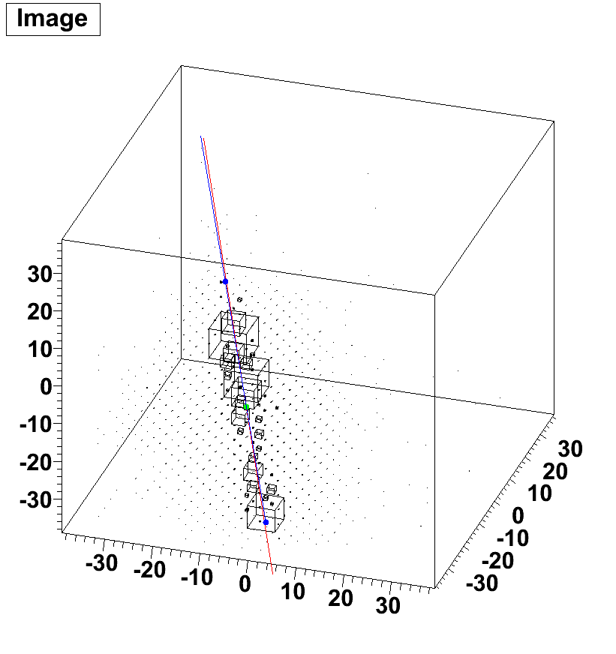
Proton #1

Slide 51
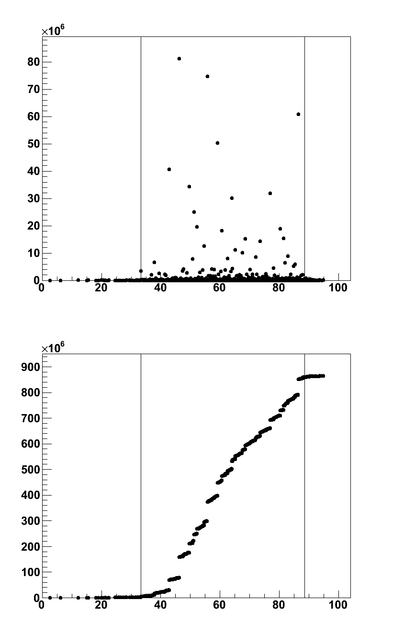
Longitudinal profile
Proton #1
Signal
cm
Shower starting point is identified with ~1 cm resolution
Integral Signal
cm

Slide 52
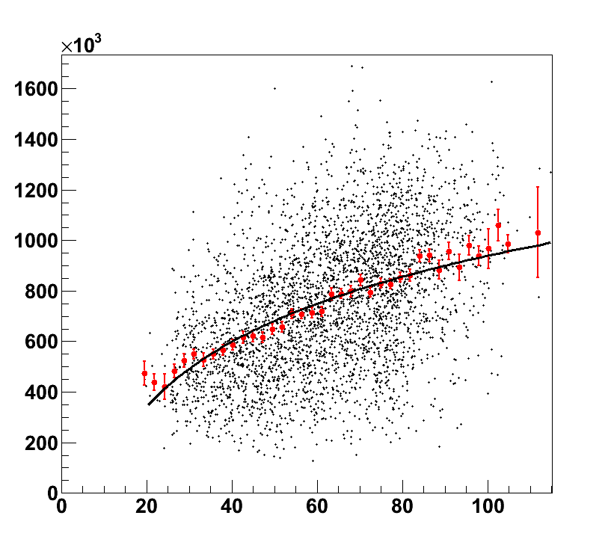
Proton 100 – 1000 GeV
Shower length can be used to reconstruct the correct energy
Red points: profile histogram
Fitted with exponential functions
To get the correct energy measurement
Signal / Energy
Shower Length (cm)

Slide 53
Proton energy resolution
32%
35%
100 – 1000 GeV
1 TeV
39%
10 TeV
40%
100 TeV
( Measured Energy – Real Energy ) / Real Energy

Slide 54
Efficiencies and Geometrical factors
GF(1 face) = 0.78*0.78*π m² sr= 1.91 m² sr
GF(5 faces)= 1.91*5 m² sr = 9.55 m² sr
Energy | ε | Energy resolution | Gfeff (m²sr)
100-1000 GeV | 35% | 32% | 3.3
1 TeV | 41% | 34% | 3.9
10 TeV | 47% | 38% | 4.5
Selection cuts can be tuned to optimize the parameters
Roughly speaking: GF>3 m²sr with good energy resolution!!!!

Slide 55
Some caveats….
Please note:
The theoretical previsions for the knee region are really very much spread out!
Pre-PAMELA-ATIC-CREAM scenarium: simple single power low up tp the knee region
Post-PAMELA_ATIC_CREAM scenarium: the models have to exaplain the change in slope around 200 GV/c, and the different slopes btw protons and helium
Differents sources, different injectiuon spectra, closeby sources,,non standard propagation scenarium….
Many works have been published in the last few years:
Thoudam and Horandel
Zatsepin, Panov, Sokolskaya.
Bernard, Delahaye, Keum, Liu, Salati, Taillet
Yuan, Zhang, Bi
Tomassetti
Blasi, Amato, Donato, Serpico
As a results, the expected spectrum around knee is unclear, and probably higher than the one expected up to few years ago
Possible structures may arise?
Direct measurementes are really essential!
With the propsed calorimeter, we could measure well above the knee
I can give you references if you are interested

Slide 56
A spot on the pre-prototype test beam (μ beam)
PD Only
PD Only
PD Only
PD Only

Slide 57
A spot on the pre-prototype test beam (μ⁻ beam)
PD Only
PD Only
PD Only
PD Only

Slide 58
A spot on the pre-prototype test beam (e⁻ beam)
PD Only
PD Only
PD Only
PD Only

Slide 59
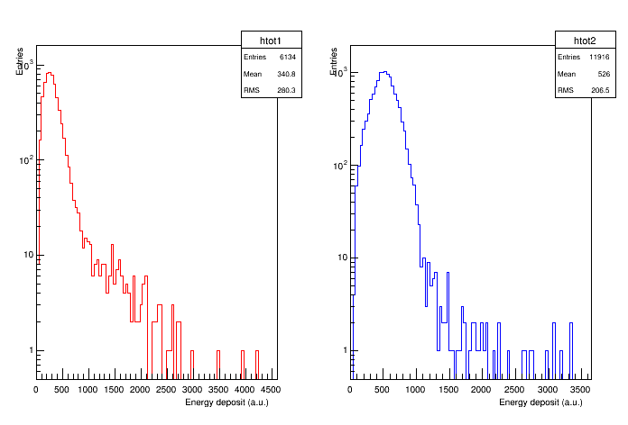
Energy resolution
∼82% (RMS)
∼39% (RMS)
Z=2
Z=1
12.8 GV
Starting-layer ==2

Slide 60
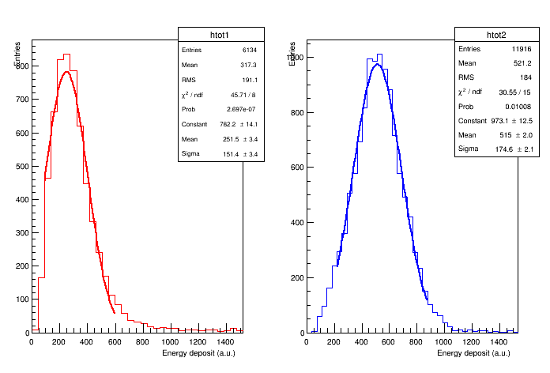
Energy resolution
∼60% (fit)
∼34% (fit)
Z=2
Z=1
12.8 GV
Starting-layer ==2

