Slide 1
Cherenkov Telescope Array CTA
Massimo Persic
INAF + INFN Trieste
for CTA Consortium
Trieste, May 3, 2013

Slide 2
Outline
Ground-Based gamma-ray astronomy
Physics questions left by the current instruments
The Cherenkov Telescope Array
Sensitivity Requirements
Current Status & Design Study, e.g.
Example MC simulation
Location Studies
Possible Schedule
CTA in Context
Conclusions
Credits to:
A. De Angelis, J. Conrad, G. Hermann, J. Hinton, W. Hofmann, M. Martinez, M. Mariotti, D. Mazin, A. Moralejo, S. Nolan, S. Ritz, Th. Schweizer, M. Teshima, D. Torres

Slide 3
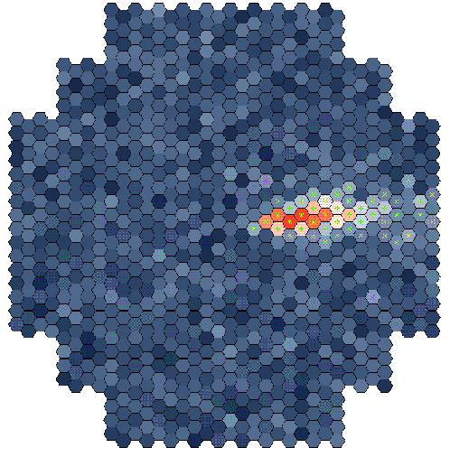
Detection Method
Potentially 5 decades of energy accessible via this technique (~few GeV to few hundred TeV)
1 decade of overlap with satellite experiments

Slide 4
Ground Based γ-ray Astronomy

Slide 5
Ground Based γ-ray Astronomy

Slide 7
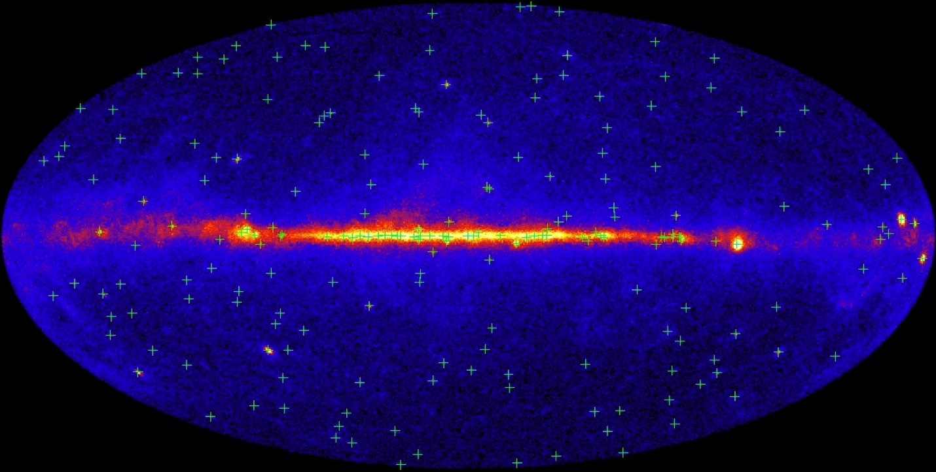
And … the FERMI satellite
Green crosses: 205 brightest LAT sources
EGRET on the Compton Obs. found <30 sources above 10σ in its lifetime.
Typical 95% δr is <10’. (For brightest src, it is <3’.) Improvements expected.
About 1/3 of the sources show definite evidence of variability.
>40 sources have no associations with known γ-ray emitting classes of objects.

Slide 8
Current Status of VHE ap
The current generation of telescopes (H.E.S.S. / MAGIC / VERITAS) have detected >100 sources.
Several more with HESS2 / MAGIC2 / upgraded VERITAS
Stellar Winds
Supernova Remnants
Pulsar Wind Nebulae
Binary Systems
Molecular Clouds
Galactic Centre
No Counterpart/Dark Sources
AGN
Constraints on EBL
Constraints on QG
CR Electron Spectrum
Regular observations made between 70 GeV-20 TeV with few % Crab sensitivity

Slide 9
Science Potential
adapted by Hinton from
Horan & Weekes 2003
Distance kpc Mpc Gpc
Starbursts
Blazars
SNR/PWN
Radio Gal.
Binaries
Pulsed
Current
CTA
Sensitivity
Flux
Colliding
Winds
Clusters
GRBs
+Dark Matter
Current instruments have passed the critical sensitivity threshold and reveal a rich panorama, but this is clearly only the tip of the iceberg
What big science questions remain ?

Slide 10
Big Science Questions
Determining
Origin of galactic cosmic-rays
Whether γ-ray binaries emit via wind/jet
Studying
Star formation regions
Pulsars and PWN
Studying Physics of AGN Jets
Galaxy clusters: the dark side of structure formation.
Constraining
Extragalactic Background Light
Quantum Gravity Energy Scale
May detect WIMP annihilation
Dark sources / New source classes

Slide 11
CTA tech wish list
Higher Sensitivity at TeV energies (x10)
Deep Observations → More Sources
Higher Detection Area
Greater Detection Rates → Transient Phenomena
Better Angular Resolution
Improved morphology studies → Structure of Extended Sources
Lower Threshold (some 10 GeV)
Pulsars, distant AGN, source mechanisms
Higher Energy Reach (PeV and beyond)
Cutoff region of galactic accelerators
Sources of UHECRs?
Wide Field of View
Extended Sources, Surveys

Slide 12
A few examples of science cases
for CTA …

Slide 13
… and a few open issues for CTA!.
Spectral degeneracy at
TeV energies
HESS J1834-178
AGILE
Fermi
CTA
uuu
MAGIC
Hadronic: 2M⊗ of target gas, exp-cutoff proton distrib: α=2.1, E_{c}=100 TeV,
n_{p}=6cm⁻³, L(0.4−6 TeV)=2.5E+34erg/s
Leptonic: B=10mG, exp-cutoff electron distrib: α=2.0, E_{c}=20TeV
D = 4 kpc
low E_{thr} (~10-30 GeV)
to discriminate
VHE γ-rays:
hadronic or leptonic ?
CTA → improved low-E coverage, solve spectral degeneracy

Slide 14
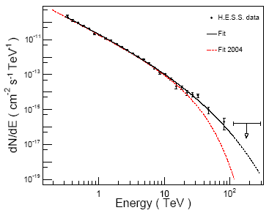
Origin of Galactic CRs from SNRs
J1713.7-3946
Leptonic:
E_{e} ~ 20 (E_{γ} )^{1/2} TeV
~ 110 TeV … but KN sets on .. → ~100 TeV
Hadronic:
E_{p} ~ E_{γ} / 0.15 ~ 30 / 0.15 TeV ~
~ 200 TeV = 10^{5.3} GeV
Importance of improving statistics: 3 years of HESS data
1 year
CTA: improved statistics at E_{γ} > 100 TeV, to probe CR knee

Slide 15
Measurement of diffusion coefficient (cf diffusion-loss equation)
Aharonian + 2006
• index Γ~2−2.2 (strong NR shock)
• little variation across SNR
CTA → spatially resolved spectroscopy
young SNRs (t<t_{cool} (p,e)):
CRp spectrum γ = 1+2α + b
→ measure κ(p) as a function of p
= p^{b} … b~0.6 ?
from secondary/primary
ratio
diffusion coefficient:
κ(p) ∝ A p^{b}
from VHE
from radio

Slide 16
Cosmic Rays and Star Formation
CR – SN relation (Ginzburg & Syrovatskii 1964)
v Fermi-I mechanism → SNRs
v SN rates, massive star formation
γ-ray (measured)
Milky Way
normalization
U_{p} ~ ¼ (ν_{SN} τ₋) (η E_{ej}) r_{s}⁻³
Test:
observed
observed
CTA to observe (detect) more SF galaxies:
LG gals, NGC 4945, NGC 1068
Strong CR production in SF gal’s:
universal acceleration efficiency of SN?
Fermi acceleration at work (NR strong shock)?
CRp diffusion

Slide 17
NGC 253 → 250 eV cm-3
M 82 → 220
Milky Way → 1
M31 → 0.35
LMC → 0.25
SMC → 0.15
obs’d
η ≈ 5%
obs’d
SN rate
particle
accel. eff.
SB radius
U_{p} ~ ¼ (ν_{SN} τ₋) (η E_{ej}) r_{s}⁻³
protons’
lifetime
E_{ej} ≈ 10⁵¹erg
kin. energy
of SN ejecta
pp collisions
(σ_{pp} cn_{p} )⁻¹ ~ 2 x 10⁷ n_{p} ⁻¹ yr
τ_ ≈
3 x 10⁴ (r_{s}/0.3 kpc) (v_{out}/2500 km s⁻¹)⁻¹ yr
advection
N 253
M 82
MW
M31
LMC
SMC
191 eV cm⁻³
240 eV cm⁻³
1.0 eV cm⁻³
0.7 eV cm⁻³
0.2 eV cm⁻³
1.0 eV cm⁻³
0.12/yr
0.25/yr
0.02/yr
0.01/yr
2 E-3/yr
1 E-3/yr
2.0E+4 yr adv
2.6E+3 yr adv
5.0E+6 yr pp
2.0E+7 yr pp
1.0E+7 yr pp
4.0E+7 yr pp
0.20 kpc
0.26 kpc
3.0 kpc
4.2 kpc
3.0 kpc
2.1 kpc
iif CRp advected by diffusion v_{diff}=100 km/s → U_{p}=0.15 eV/cm³

Slide 18
Gamma-Ray Bursts (GRBs)
• Most energetic explosions since Big Bang (10⁵⁴ erg if isotropic)
• Astrophysical setting unknown (hypernova?)
• Emission mechanism unknown (hadronic vs leptonic, beaming,
size of emitting region, role of environment, … … )
Cosmological distances (z >> 1)
Missed naked-eye GRB 080319B (z=0.937)
Gggg
HESS
MAGIC
----------------------------------------
MAGIC
ST
CTA → low E_{thr} ~ 20 GeV
to see GRBs !!

Slide 19
GRBs
080319B → missed obs of “naked-eye” GRB
Intrinsically:
Nearby: z=0.937
Brightest ever observed in optical
Exceedingly high isotropic-equivalent in soft γ-rays
Swift/BAT could have observed it out to z=4.9
1m-class telescope could observe out to z=17
Missed by both AGILE (Earth screening) and MAGIC (almost dawn)
next BIG ONE awaited !!

Slide 20
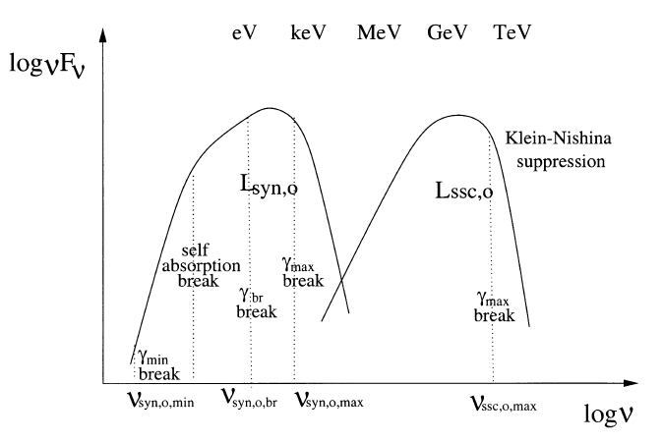
AGN
Short-term simultaneous SEDs of low-z blazars.
Quiescent states of low/intermediate-z blazars.
High states of high-z blazar.
IACT
CTA

Slide 21
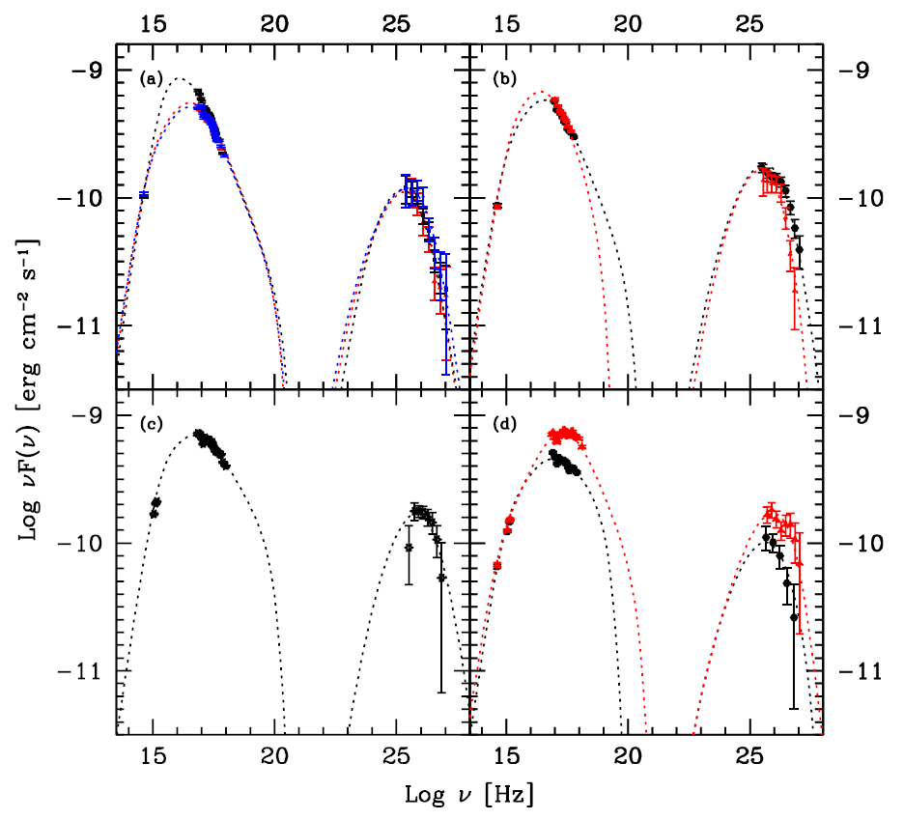
Mk 421
Flare of
Mar/Apr 2008
Aleksic + 2012

Slide 22
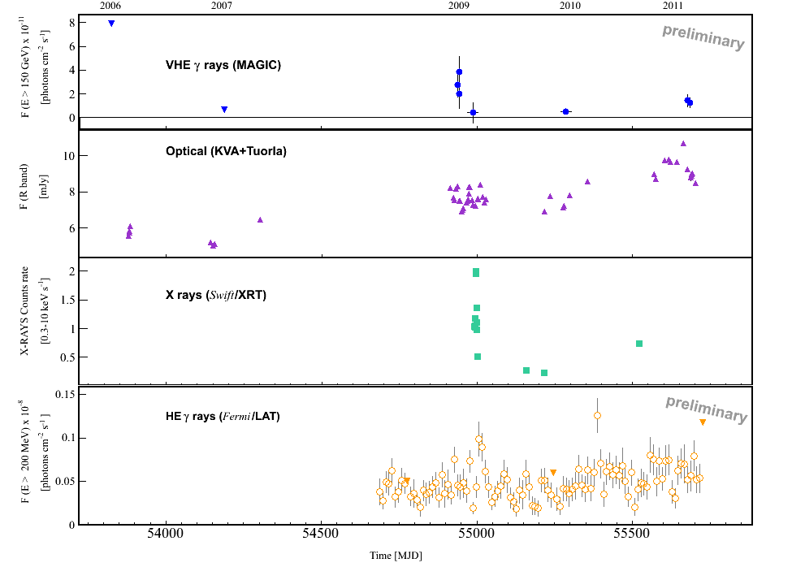
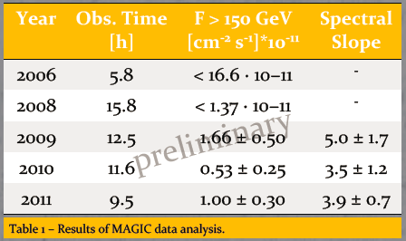
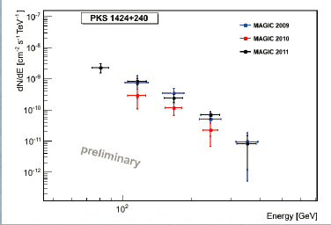
PKS 1424+240 Prandini et al. 2012
detected by VERITAS, confirmed by MAGIC (2009)
Detected by VERITAS (2009), confirned by MAGIC
New: z>0.6

Slide 23
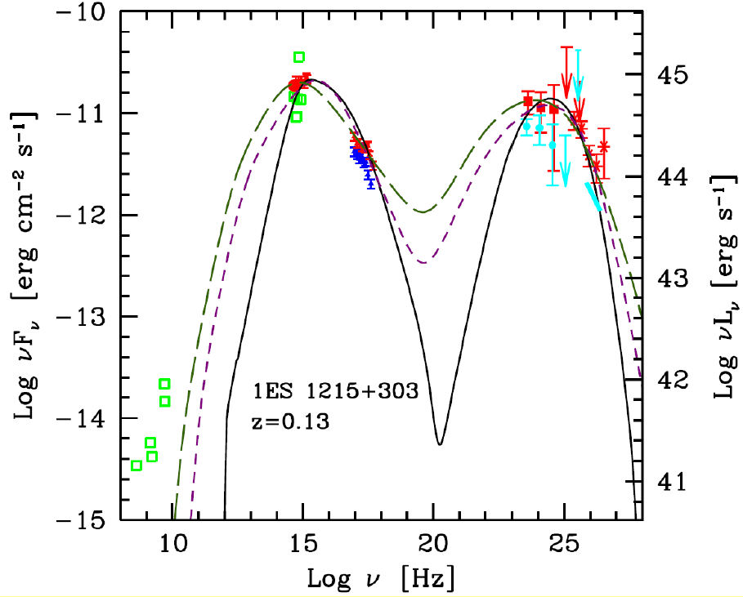
simultaneous 2011
archival
Jan-Jun 2010

Slide 24
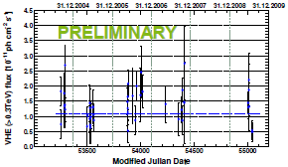
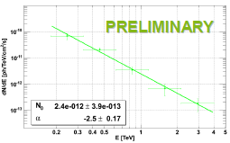
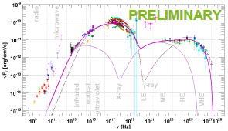
1ES 1959+650
Backes + 2012
7 Telescope Array, Whipple, HEGRA, MAGIC
2 ν detected by AMANDA (1 during orphan flare)
z = 0.048
Regular monitoring 2005-2011: 58 hr
1-zone SSC model
1-zone EC model
2-zone SSC model
Steady source.
Rich non-simult. SED.

Slide 25
Beyond blazars
New generation IACTs have established new classes of VHE active galaxies different than blazars…
Starbursts
2 — none discovered by MAGIC
No central source, probably global
emission of all CR in galaxy
Blazars (BL Lacs):
still the vast majority:
~40 — 15 discovered by MAGIC
Extensive studies
Quasars
3 — 2 discovered by MAGIC
Different physics:intense radiation fields.
Very far: useful to study EBL
Radiogalaxies
4 — 2 discovered by MAGIC
Study emission in jet: they are nearby (can be resolved
in other wavelengths) and jets not aligned with line of sight.
May be sources of UHECRs?

Slide 26
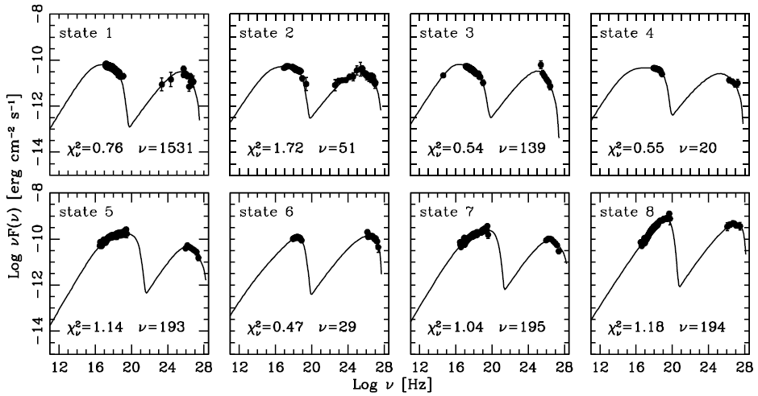
… Mk 501
Mankuzhiyil + 2012,
ApJ, 753, 154

Slide 27
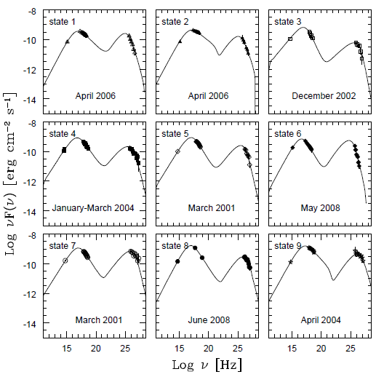
… SSC parameters vs source activity: Mrk 421
Mankuzhiyil,
Ansoldi, MP,
& Tavecchio 2011,
ApJ, 733, 14

Slide 28
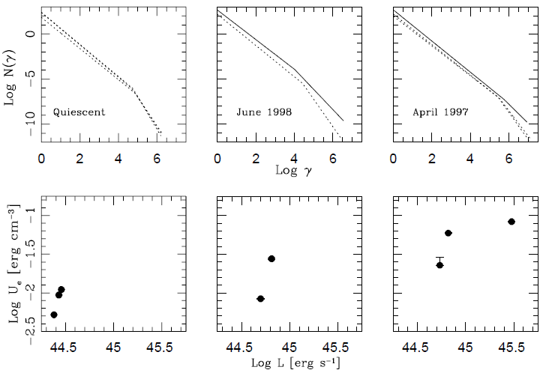
Mankuzhiyil + 2012
Mk501

Slide 29
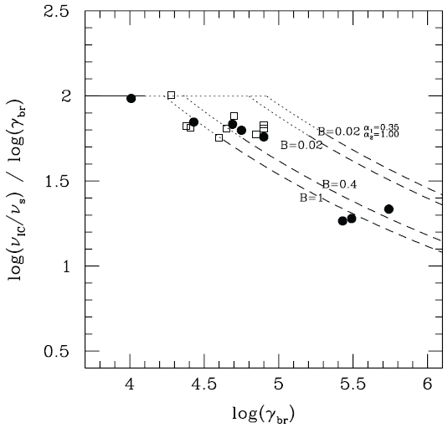
Thomson vs.
extreme K-N
scattering
regime
Thomson
extreme K-N
Mk501
q Mk421

Slide 30
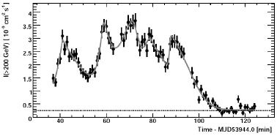
PKS 2155-304
(H.E.S.S.)

Slide 31
D A R K M A T T E R

Slide 32
Small, nearby galaxies … or … large, faraway clusters?
Let’s start from signal from self-interacting DM decay
D⁻²
→ small distances best!
→ small guys win!
→ cosmology: dSph halos are best candidates for DM signal
→ astrophysics: dSph stellar pops. are most silent astroph bkgd

Slide 33
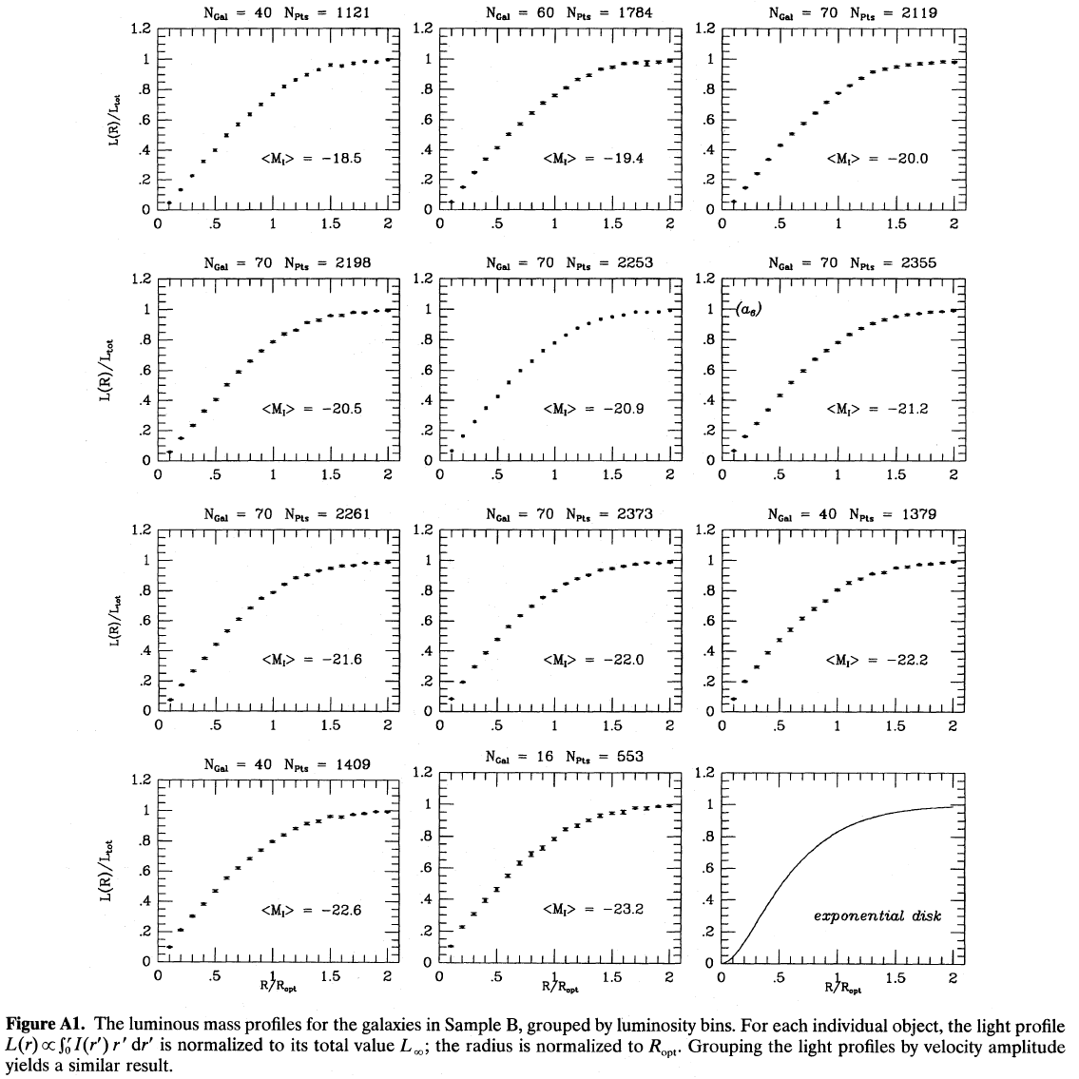
Some background
on galaxy structure ..
I(r) = I₀ exp(-r/R_{d})
same profile at
all luminosities!
1000 galaxies
Persic + 1996

Slide 34
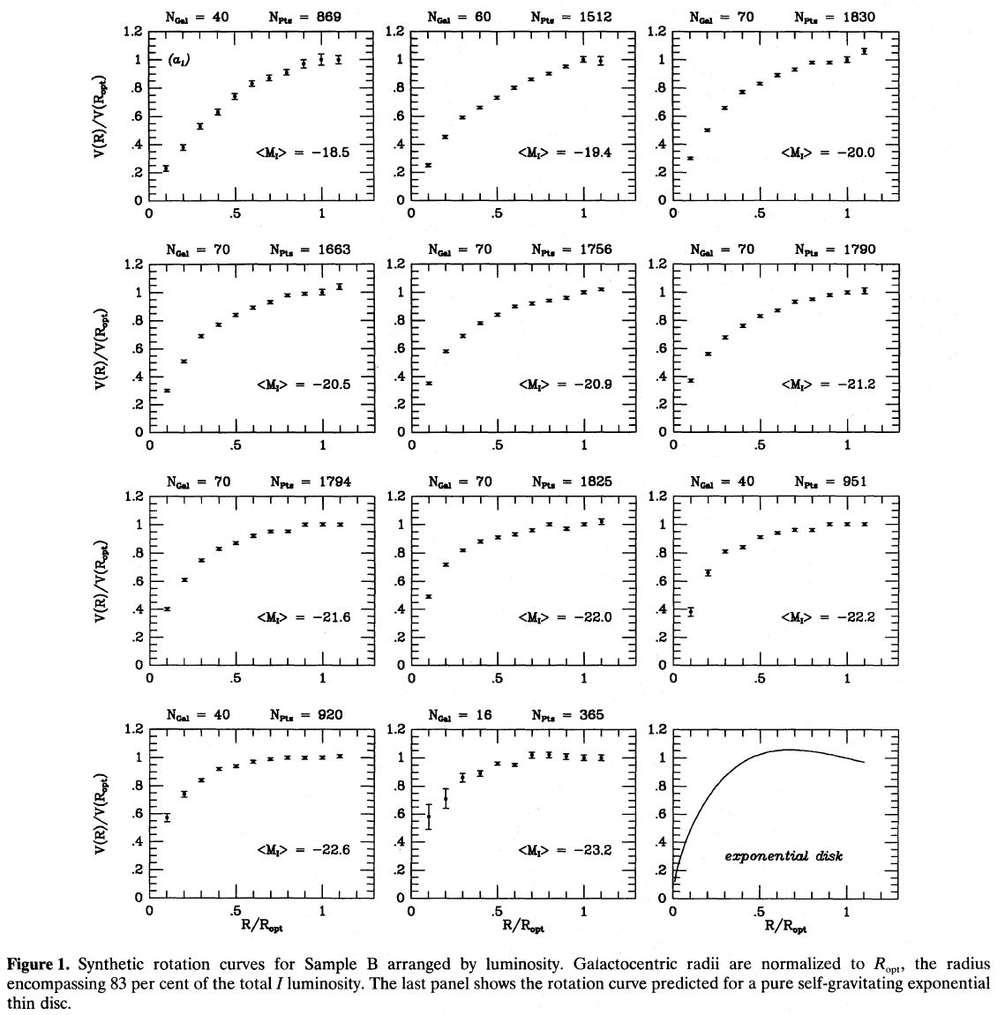
Rotation curves
are not self-similar
with luminosity!

Slide 35
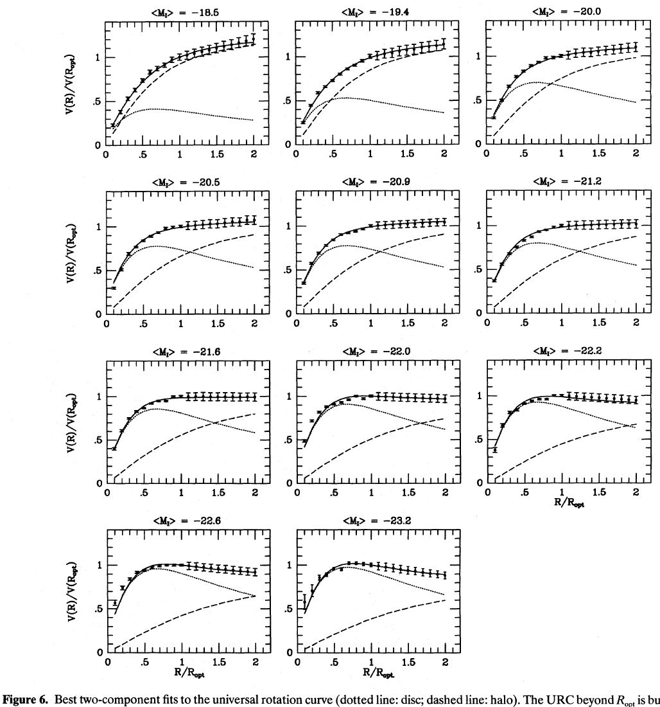
Smooth progression
of RC shape, and
disk/halo interplay,
with luminosity
Universal Rotation Curve
of spiral galaxies
Persic et al. 1996
blablablabl
lkugkfthjfftrd

Slide 36
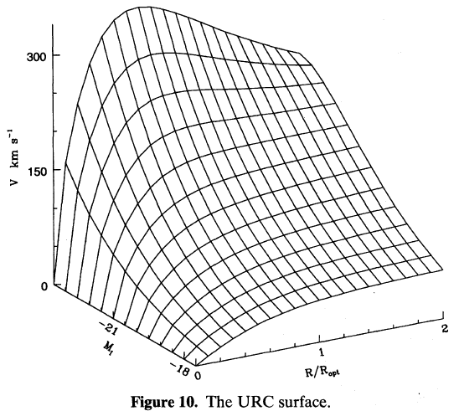
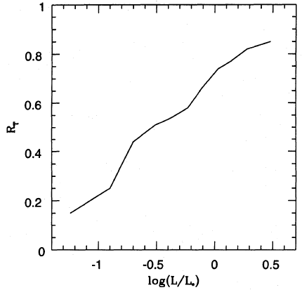
Tully-Fisher relation
R/R_{opt} when DM starts
to be dynamically felt
Rotation
curve
Persic + 1996

Slide 37
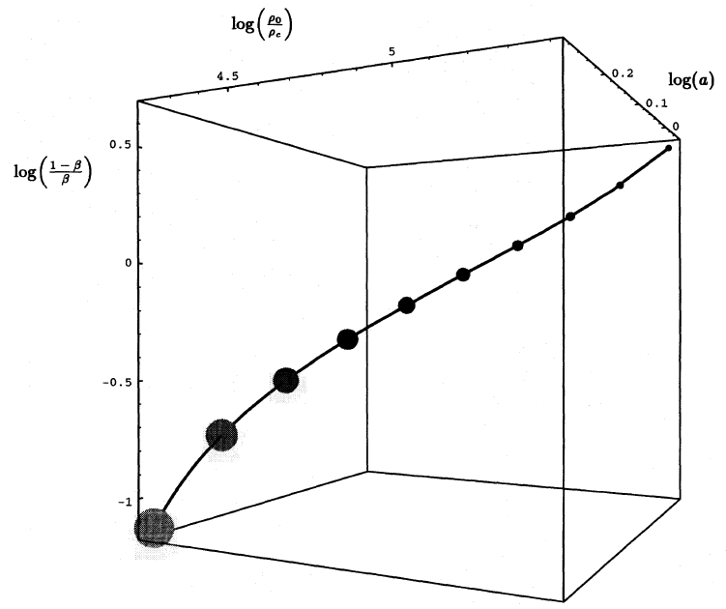
Persic+ 1996

Slide 38
Whence these properties?
Bottom-up cosmology: small galaxies formed first, hence their density retains the cosmological density at the epch of their turnaround
(δρ/ρ ∼ 1.8).
Baryon infall: SF → SN expl. → winds → most of infalling baryons lost in small gals., but retained in bigger ones.
Smaller, denser gals. have little/no SF. Bigger, less dense gals. do have gas and SF.

Slide 39
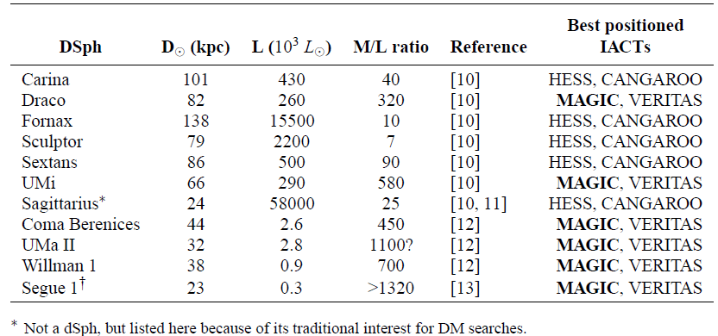
Dwarf Spheroidals: ideal DM candidates
Milky Way satellites → nearby
High M/L → DM dominated
Old stellar pop. → no ongoing SF

Slide 40
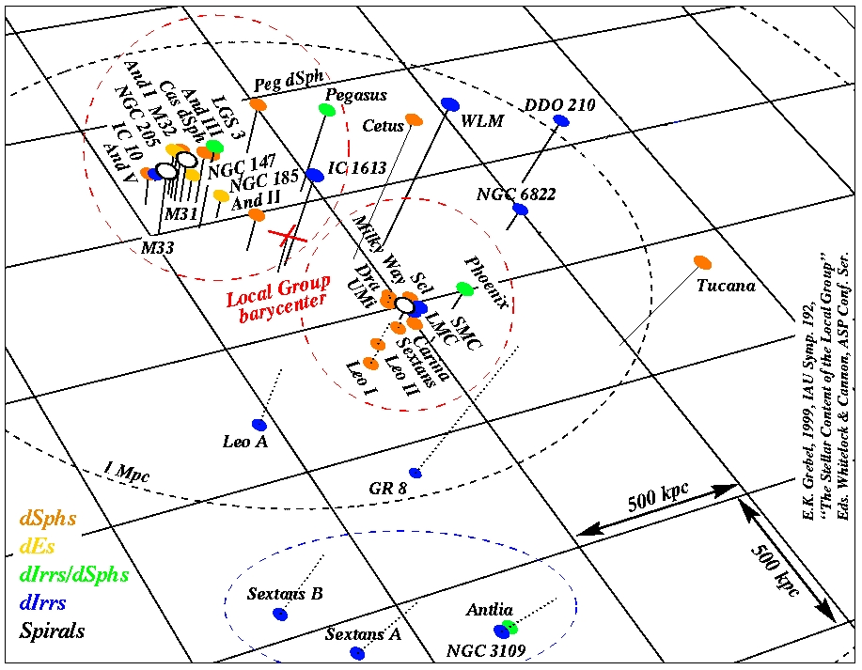

Slide 41
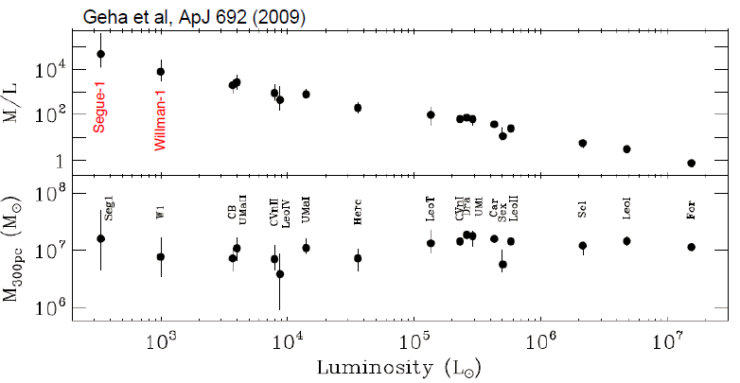

Slide 42
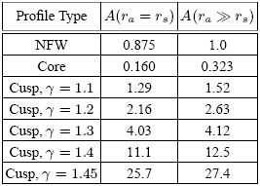
Example: Draco dSph modeling
d~80 kpc
Bergström &
Hooper 2006
total DM
annihil. rate
<σ_{A}v>, m_{χ}: WIMP annihil. cross section, mass
γ-ray flux
N_{γ}: γ-rays / annihil.
cusped
profile
upper limit
cored
profile
γ-ray flux
r_{s} = 7 – 0.2 kpc
ρ₀ = 10⁷ – 10⁹ M_{ž} kpc⁻³
ρ₀² r_{s}³ = 0.03 – 6 M_{ž}² kpc⁻³
part. phys
astrophys

Slide 43
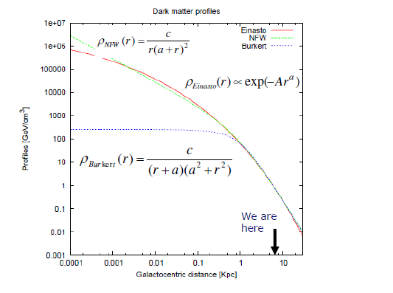

Slide 44
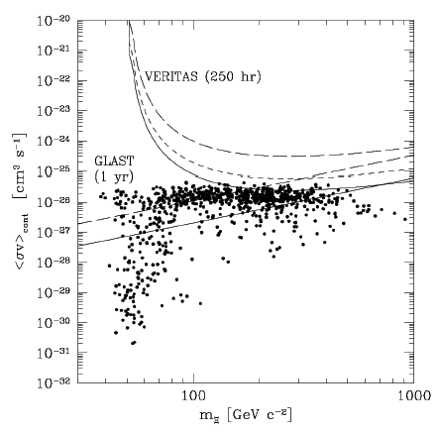
bb
t t
_
τ⁺τ⁻
_
min. cored
W⁺W⁻
ZZ
max. cusped
MAGIC
40-h exp.
Fermi LAT
1-yr exp.
Bergström & Hooper 2006
IACT neutralino detection:
<σ_{A}v> ≥ 10⁻²⁵ cm³s⁻¹
Stoehr + 2003

Slide 45
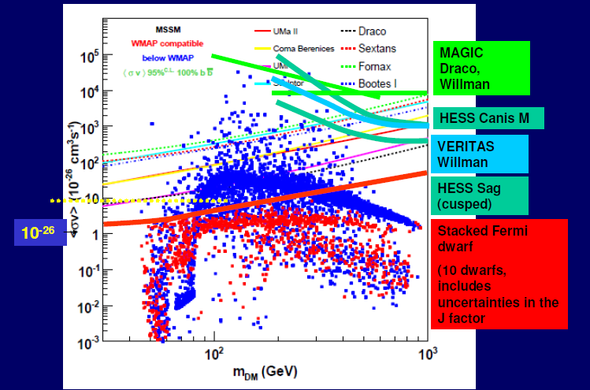

Slide 47
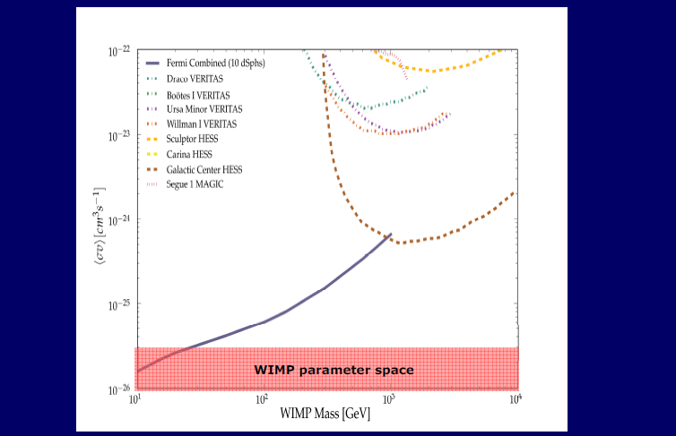
… present status

Slide 48
Weniger’s line?

Slide 49
Weniger’s line in CTA?
kgfgtfkfkgkgkhgvkgv

Slide 50
Galaxy Clusters

Slide 55
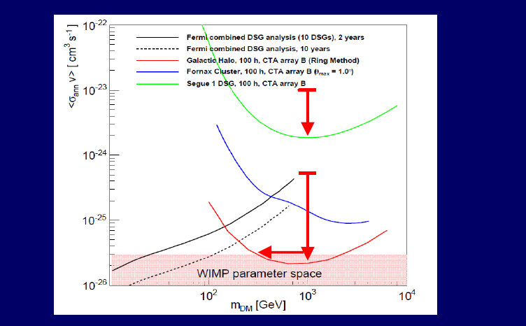
DM: future status
If detected, would
overproduce EGRB

Slide 56
Conclusions on DM

Slide 57
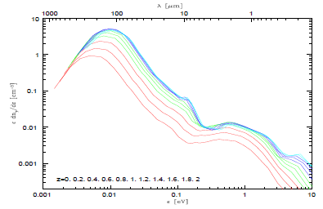
Evolution of cosmic star formation rate
Franceschini
et al. 2008
CTA’s higher-E extension (e.g.
50 TeV) will allow us to probe
poorly known sub-mm EBL.

Slide 60
Probing Quantum Gravity

Slide 61
Kjbvakj
E_{QG} ~ 0.05 M_{P}
Major improvements
expected from CTA
and ∃ no conventional explanations →

Slide 63
… in general:
Mrk 501: Jul 9, 2005

Slide 65
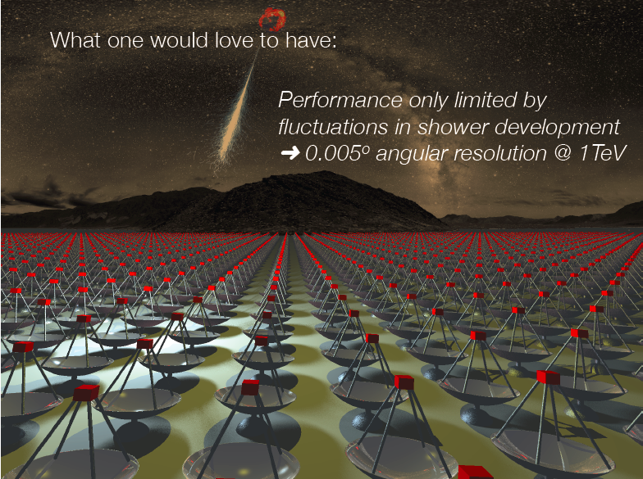

Slide 67
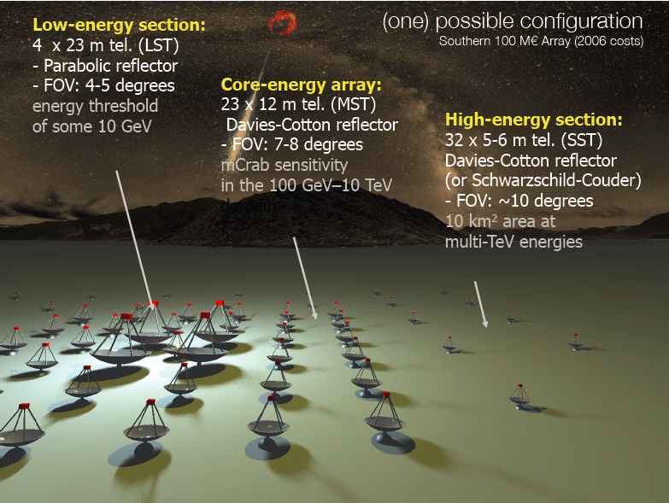

Slide 69
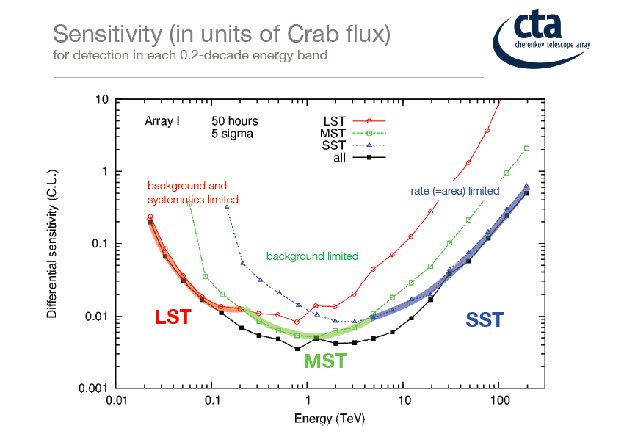

Slide 70
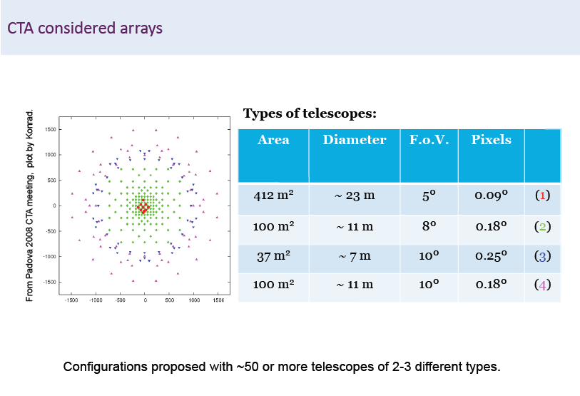
angular
resolution
field
of
view

Slide 71
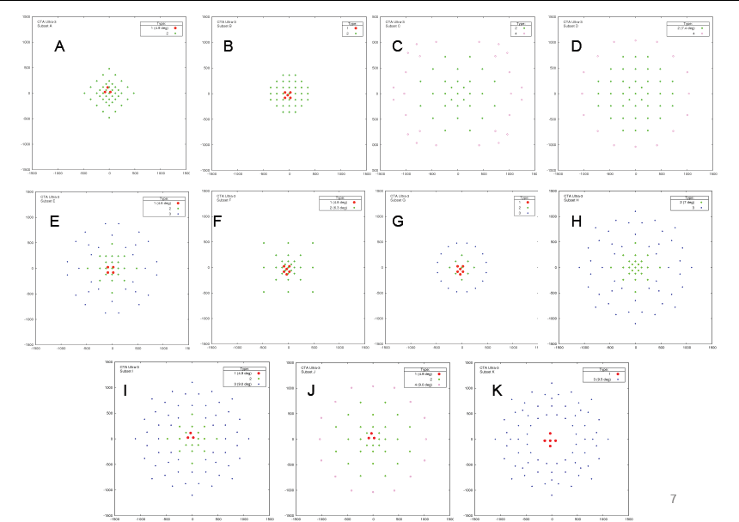

Slide 73
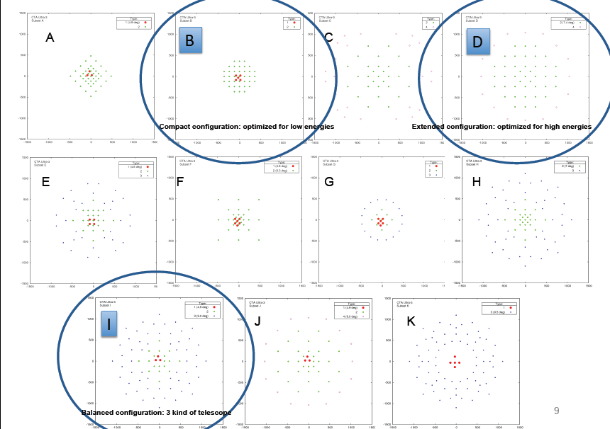

Slide 75
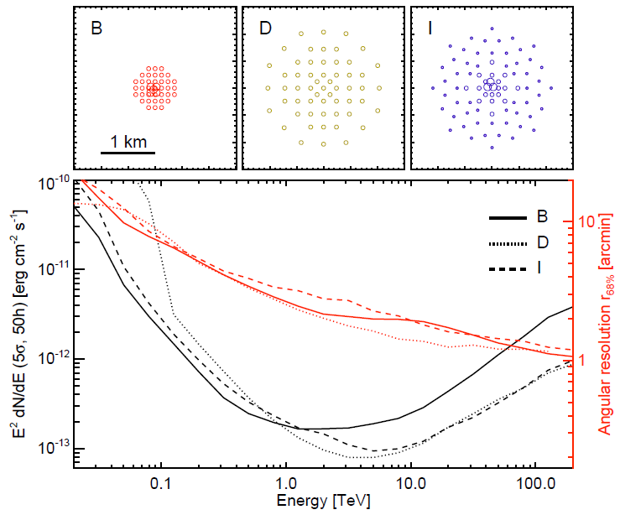

Slide 77
CTA sensitivity
tyuujunas
hjv

Slide 78
Expected Design Study Results
CTA Design started !
Detailed knowledge of characteristics, availability of a few good site candidates.
Array layout which optimises physics performance for a given cost (and which is about 1 order of magnitude better than we have now).
Detailed design and industrial cost estimates for telescopes and associated equipment
Plan how to organise, produce, install commission, operate the facility; estimate for operating cost
Model and prototype how to handle and analyse the data
Small prototype series of common components, to ensure that production issues and costs are understood.

Slide 80
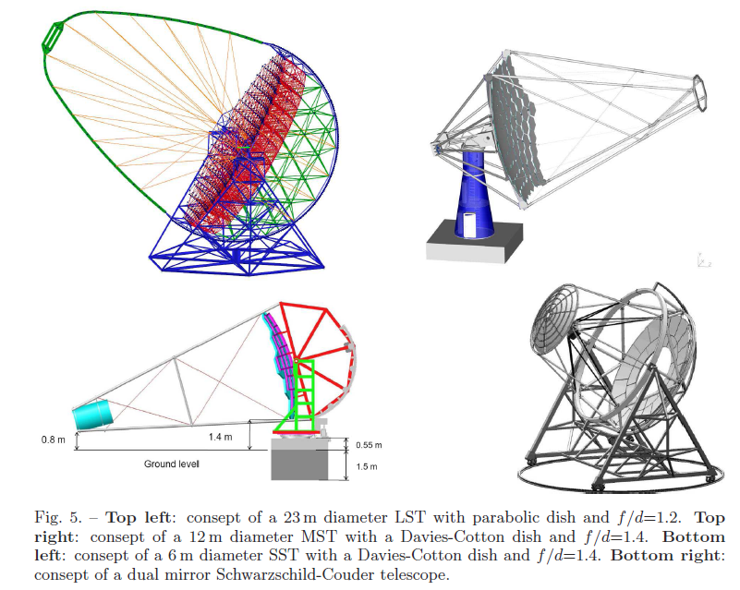

Slide 81
Lesson from MC:
Hard to beat
telescope numbers
& area covered
Cost per
telescope,
complexity
Big challenge:
cost effective production
and high reliability
Expect best overall
science performance
about here
Performance
Notes:
The CTA design philosophy is profoundly inspired in the rule of following a reasonable balance. We know how to build telescopes, and the specific lines where technical innovations are needed have already been identified. These are mostly related to the optimization of low energy threshold in the large telescopes, the mirror, electronics and photodetector technologies which have experienced a very fast evolution in the last ten years, the subsystem reliability, the atmospheric monitoring and the high capacity data storage and processing.

Slide 82
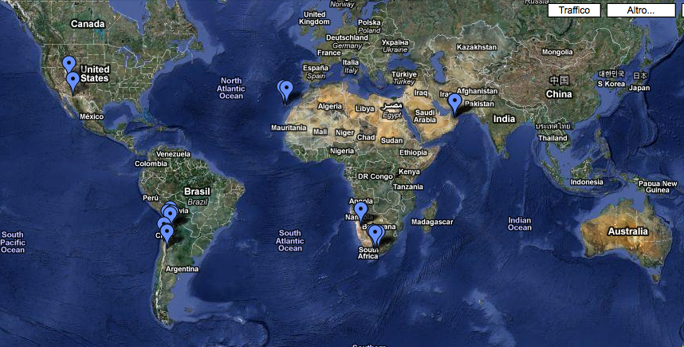
Possible CTA sites

Slide 83
Site choice
How to compare different sites? Issues include
Astronomical quality
Infrastructure cost
Access
Risks
…
In the end, it basically boils down to a cost argument:
For a given budget, which site will provide best sensitivity?
E.g. higher access cost at a remote site will imply fewer telescopes, compensating a possible gain in observation time
… of course, quantifying everything may be hard …

Slide 84
Cost
Given for ESFRI: 150 M€ investment cost (in 2006)
100 M€ south site
50 M€ north site
Escalates to about 190 M€ for 2013-2018 construction period
Update only once we have semi-realistic numbers
What if there is not enough funding secured at t₀?
An issue for the Resource Board …

Slide 85
Operating costs
Typical facilities require annual operating costs of 7% to 10% of investment cost
For CTA this would imply 13 – 19 M€ per year
For 500 CTA scientists, this is 25-40 k€ per person
About 10 x more than current instruments
Major concern for (some) funding agencies
→ Need to
Understand operating costs very well
Minimize operating costs
→ Is >10 M€ operating costs plausible?

Slide 86
Contributions to operating costs
Personnel
Management
User interfacing & proposal handling
Shift operation
Instrument maintenance
Data centers & user support
Utilities
Power
Telecommunications
Infrastructure
Site services (rooms, food, …)
Site & building maintenance
Instrument maintenance
Mirror recoating
Photosensor replacement
Travel
…
Non-exhaustive list

Slide 87
CTA : The Observatory
CTA will be a normal astrophysical observatory, open to the community, with professional operators, A0s and support for data analysis.
Data will be public after some time (1 year ?)
50% of observation time for construction consortium

Slide 88
CTA: In Context
Space-based instruments only
optical
UV | X-ray | γ-ray | VHE γ-ray
Integral
10⁻¹¹
10⁻¹²
10⁻¹³
10⁻¹⁴
10⁻¹⁵
10⁻¹⁶
Fermi GST
νF_{ν} (erg cm⁻² s⁻¹)
Current
Instruments
More sensitive
XMM
HST
1 eV
1 keV
1 MeV
1 GeV
1 TeV
1 PeV
Energy

Slide 89
Summary
The current generation of ground-based γ-ray telescopes have provided a wealth of information on many new sources
Many open physics questions remain
CTA aims to answer many of these, and provide an observatory for the wider astrophysical community
Highly ranked in many European roadmaps
The design study is underway

Slide 90
Thanks!

